Slide 1
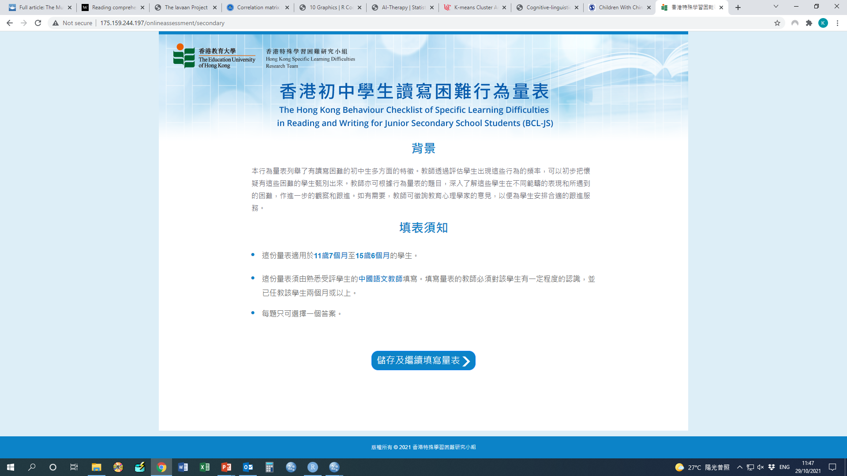
Logo issue as in BCL-P
Old version is correct, change to 開始填寫量表

Slide 2
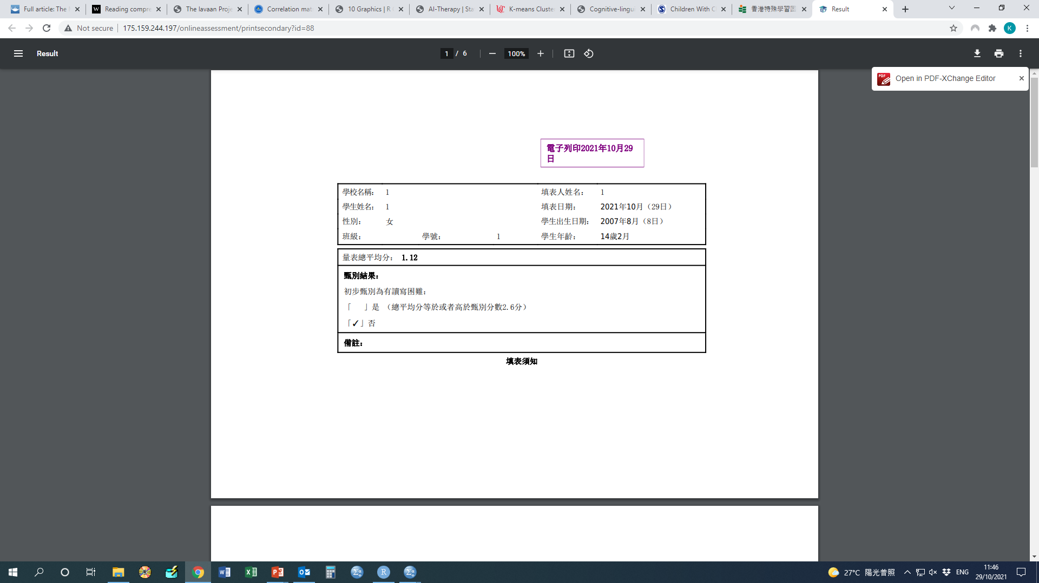
Gender is incorrect

