Slide 1
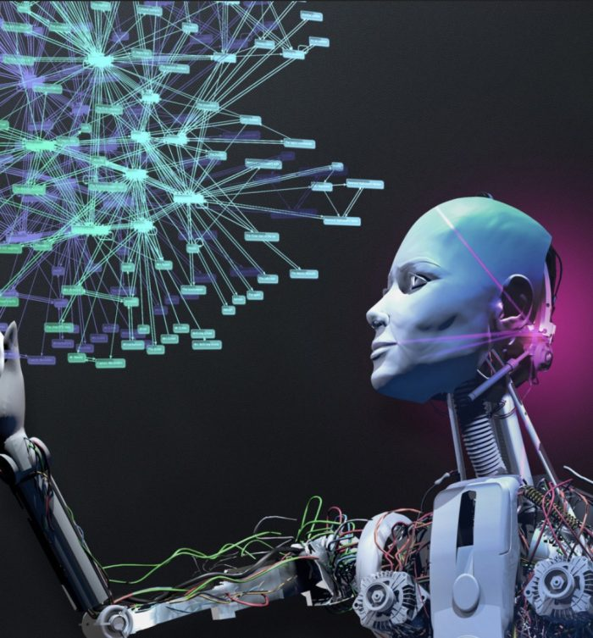
Basic Concepts, Development and Applications of Artificial Intelligence
This Photo by Unknown Author is licensed under CC BY

Slide 2
Contents
  Basic Concepts of Artificial Intelligence
  The Development and Applications of Artificial Intelligence
  Q&A
  Summary

Slide 3

  Basic Concepts of Artificial Intelligence

Slide 4
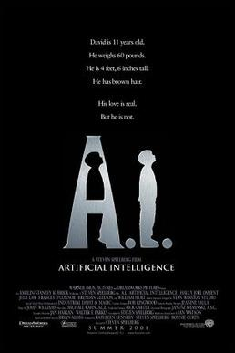
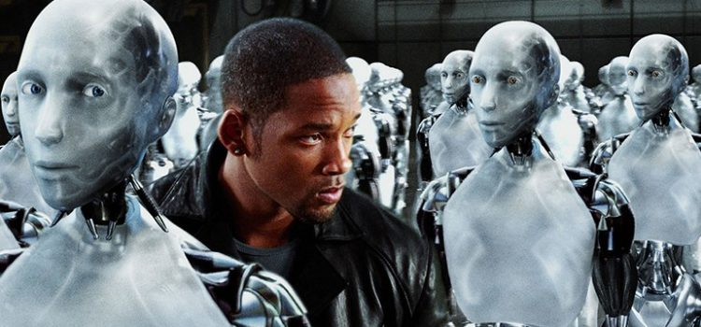
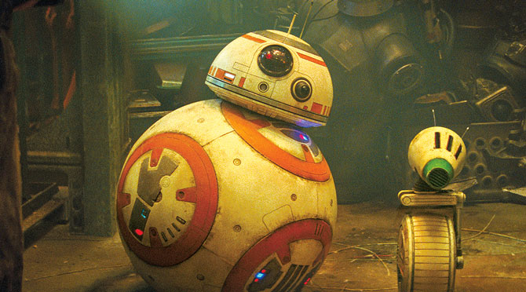
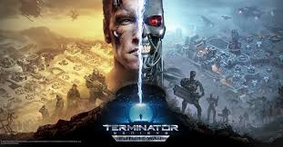
Movies containing
AI elements

Slide 5

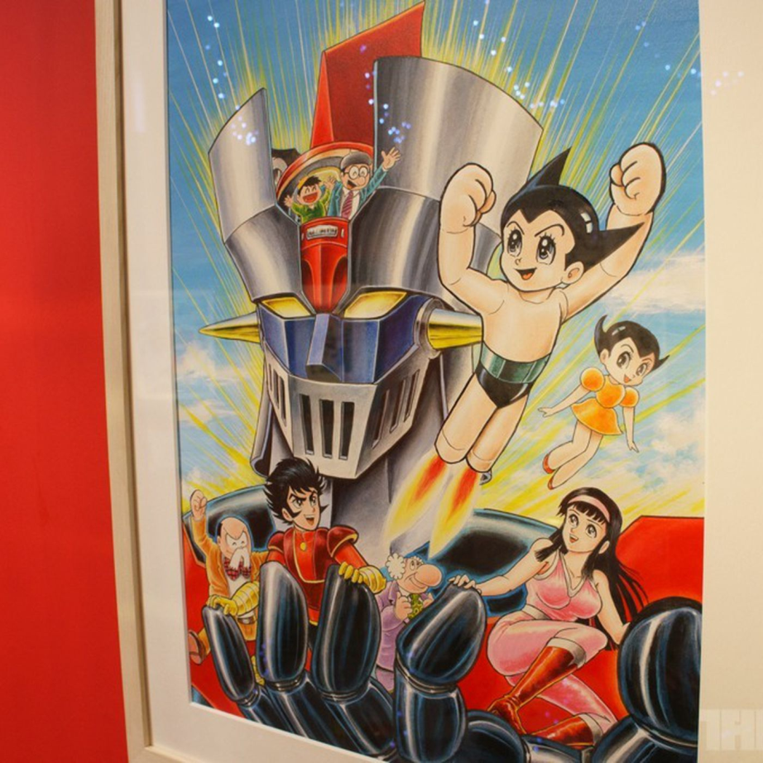
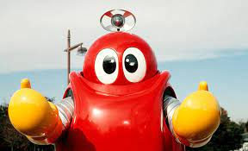
Cartoons containing AI elements

Slide 6

News about AI

Slide 7

Artificial Intelligence
Past: How did the idea of AI come about?
Present: What is the current state of AI?
Future: Will robots rule the world?
This Photo by Unknown Author is licensed under CC BY-NC

Slide 8
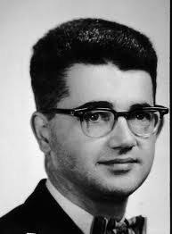
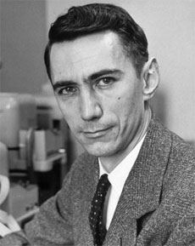
Dartmouth Conference 1956: The Birth of "AI"
Try to figure out how to get machines to use language, form abstract concepts, solve problems that humans can't solve right now, improve themselves, and so on. For today's artificial intelligence, the first problem is to make machines able to show intelligence like humans.
"We think that if we could get a good group of scientists to work together for a summer, we could make significant progress on these issues.”
John McCarthy (Dartmouth College), Marvin Minsky (Harvard University), Nathaniel Rochester (IBM), and Claude Shannon (Bell Telephone Laboratories) etc.

Slide 9
The History of Artificial Intelligence
Trends
Deep learning, big data, and computing speed have increased dramatically
Speech recognition, expert systems, neural networks
There are a lot of
top-level algorithms
The technology is not good enough to meet the high expectations of AI
Insufficient computing abilities
Time
1950 1960 1970 1980 1990 2000 2010 2020

Slide 10
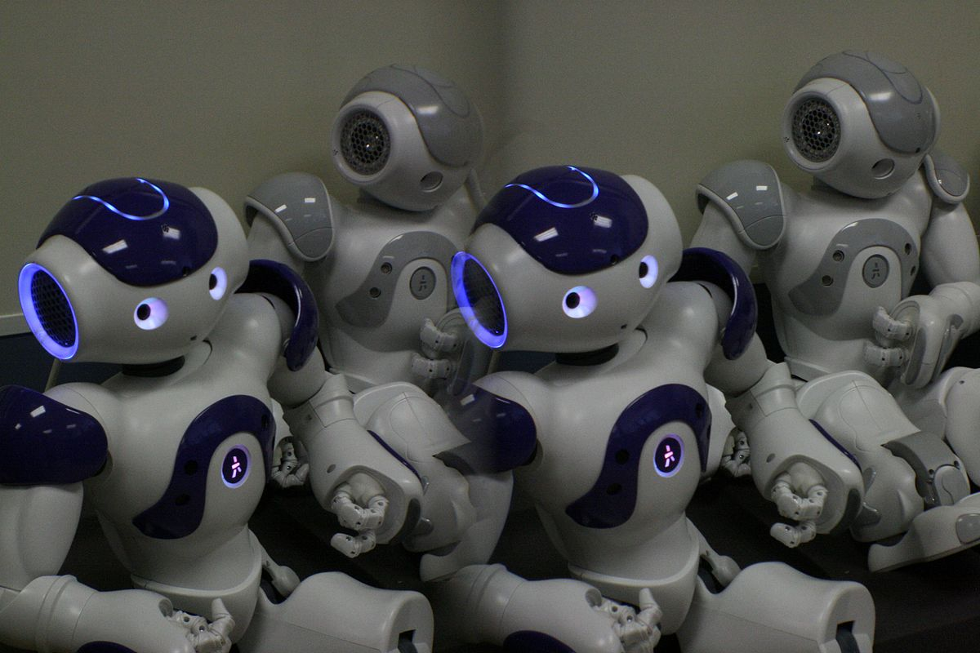
What is artificial intelligence?
Is artificial intelligence a robot?
This Photo by Unknown Author is licensed under CC BY-SA

Slide 11
Definition of Artificial Intelligence
Artificial intelligence refers to machines made by humans that can show intelligence. It usually refers to the ability of computers to "simulate" human thought processes or to "demonstrate" human behavioral abilities.
For example: reasoning, knowledge, planning, learning, communication, perception, the ability to use tools and manipulate machinery, etc.

Slide 12
The Difference Between Artificial Intelligence and Robots
The common mechanical arm or home sweeping robot in the factory can automatically detect and achieve accurate actions, but it may only use computer sensing and automation technology, and does not adopt AI learning, reasoning, and prediction. Therefore, artificial intelligence is a computer-science core technology independent of robots. Its applications are more extensive, including face recognition and speech recognition, not limited to robots.

Slide 13

What can Nowadays AI Do?
Recognize objects in images
Write bug-free software
Translate between languages
Speak
Predict the future of our universe
Feel empathy or sympathy

Slide 14
    What Can AI Do?
Robotics is only one area of research in artificial intelligence. The broader research areas also include computer vision, fingerprint recognition, face recognition, retina recognition, iris recognition, palmprint recognition, expert systems, automatic planning, automatic programming, intelligent control, language and image understanding, intelligent Q&A, natural language processing, intelligent search, automatic reasoning, machine learning and so on.

Slide 15
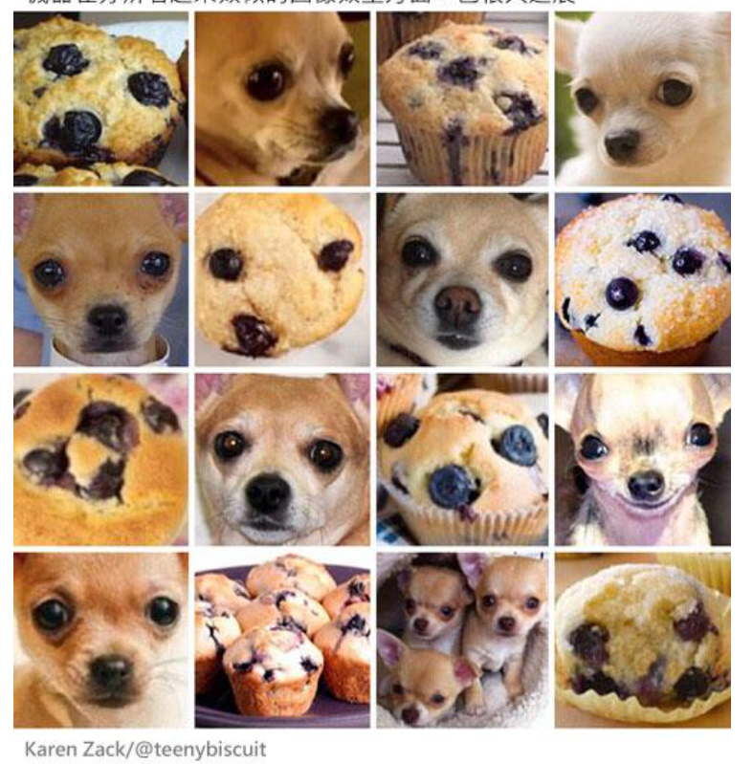

Slide 16
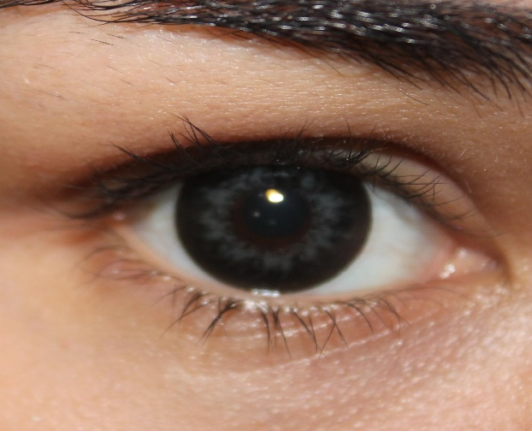
(1) AI Can Be Our Eyes
Computer Vision
The ability to identify objects, scenes, and activities in images. Break down image analysis tasks into small, easy-to-manage tasks. For example, the edges and textures of objects are detected from the image. Classification techniques can be used to determine whether the identified features represent a class of objects known to the system.
Widely used in medical imaging analysis to improve disease: prediction, diagnosis and treatment; in facial recognition by Facebook to automatically identify people in photos; in surveillance to identify suspects; in shopping, where consumers take photographs of products with their smartphones for more purchase options.
This Photo by Unknown Author is licensed under CC BY

Slide 17
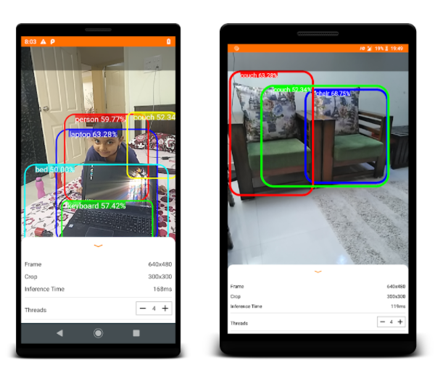

Demo 1: Object Detection TensorflowLite Demo
Search and download the Object Dection TensorflowLite Demo from the mobile playstore/Appstore to identify objects after installation.

Slide 18

(2) AI Can Be Our Ears
Speech recognition technology
Can transcribe human speech. There are some problems similar to natural language processing, such as the processing of different accents, background noises, and the differentiation of homophones.
The main applications of speech recognition include medical dictation, voice writing, computer system voice control (1083 Hong Kong telephone number inquiry), telephone customer service, etc.
This Photo by Unknown Author is licensed under CC BY-NC

Slide 19



Demo 2: Speech Recognition (1083 Hong Kong Phone Number Enquiry)
1. Call 1083 for enquiries.
2. After connection, press  to enquire about government departments and public institutions.
3. Then say the name of the government department or public agency you want to check.
4. The query system will search for data based on your voice input.
This Photo by Unknown Author is licensed under CC BY-NC

Slide 20
(3) AI can Communicate With Us
Natural Language Processing (NLP)
If artificial intelligence wants to communicate with people, it must understand human language, which is called natural language understanding, and is a very important challenge in artificial intelligence research.
Strong AI: possesses consciousness, personality, emotion, perception, social and other human traits.
Weak AI: simulates the intelligent behavior of humans in a narrow domain.

Slide 21
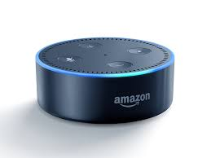
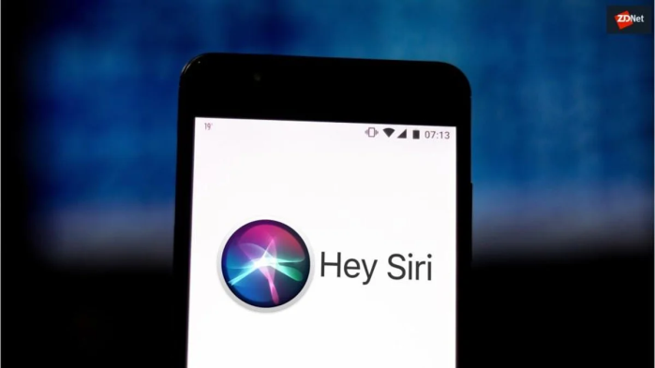

Demo 3: Artificial Intelligence Assistants (Amazon Alexa, Google Assistant, or Apple Siri)
Demonstrate the operation of one of the AI assistant software

Slide 22
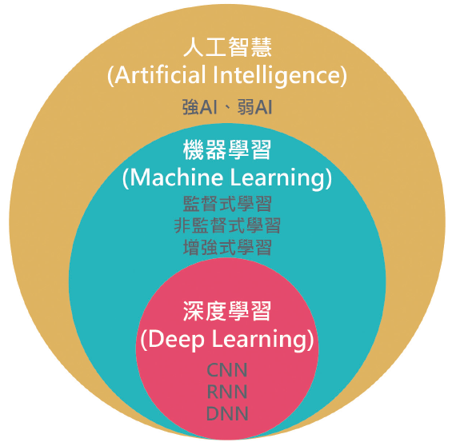
      (4) AI Can Learn and Think Like We Do
Machine Learning: is an approach to AI that involves learning by itself. It improves on itself, as it digests more data, i.e., to perform the specific task with increasingly greater accuracy.
Deep learning: is a subfield of machine learning that is based on training deep neural networks. It teaches itself to perform a specific task with increasingly greater accuracy, without human intervention.
Artificial Intelligence
Strong AI, Weak AI
Machine Learning
Supervised learning
Unsupervised learning
Reinforcement learning
Deep Learning
CNN
RNN
DNN

Slide 23
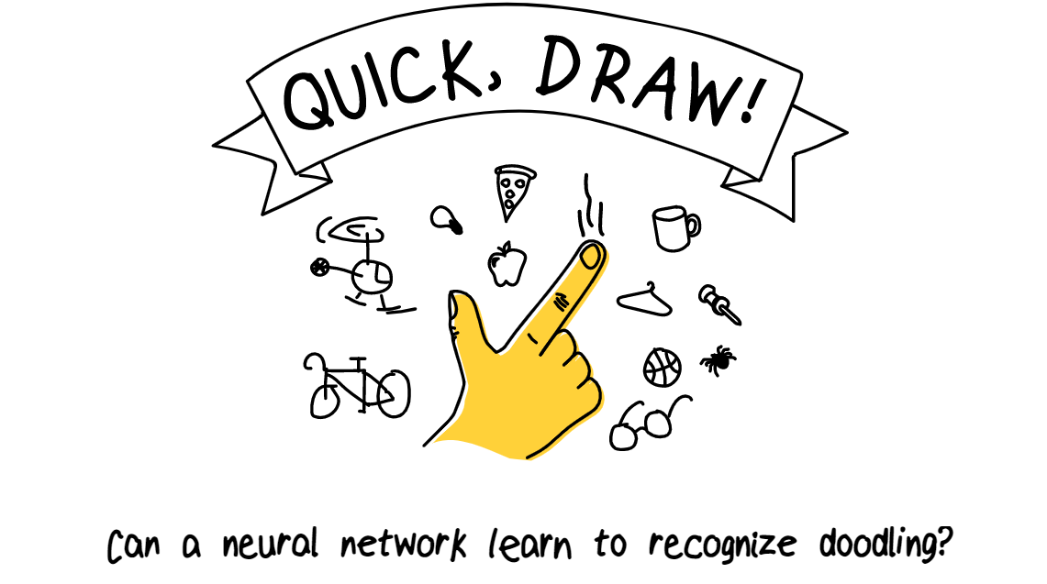
Demo 4: Machine Learning (QuickDraw)
Is an online game developed by Google; the player draws the graphics according to the given topic and the artificial neural network (AI) guesses the content represented by the graphics in real time.
https://quickdraw.withgoogle.com/

Slide 24
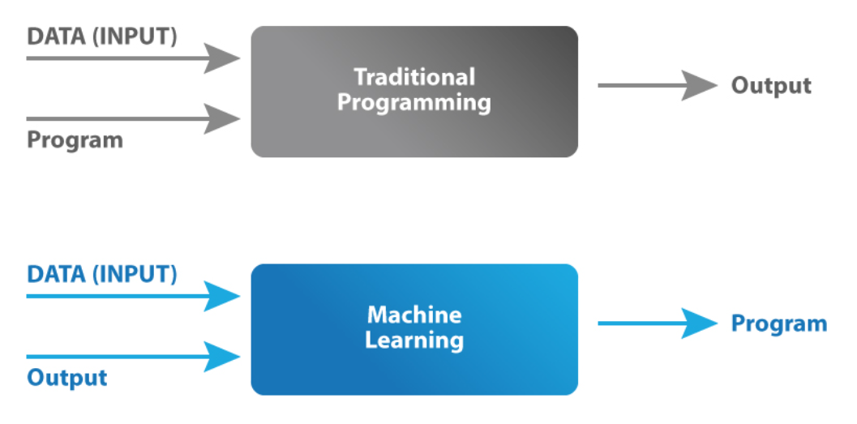
Difference Between Machine Learning and Traditional Programming
Source: https://www.mygreatlearning.com/blog/what-is-machine-learning/

Slide 25
      Types of machine learning
Supervised learning: Involves making the algorithm learn the data while providing the correct answers or the labels to the data.
Unsupervised learning: Doesn’t have correct answers or any answers. It is up to the algorithms discretion to group together similar data and understand it.
Reinforcement learning: Just as children are generally “reinforced” with certain behaviours through the principles of either rewarding them when doing the right thing or punishing upon doing something wrong.

Slide 26
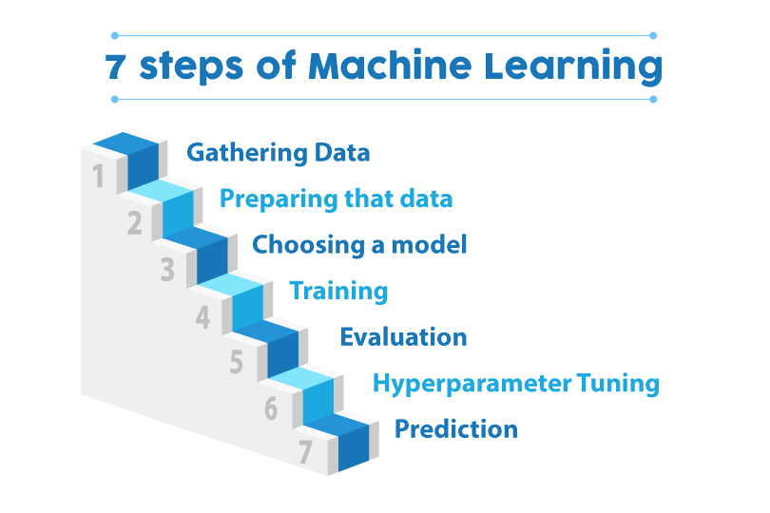
    7 steps of machine learning
Source: https://www.mygreatlearning.com/blog/what-is-machine-learning/

Slide 27

(5) AI can be Our Good Helper
Artificial intelligence can be said to be a very high-end technology, the support behind this technology is massive data mining and analysis, most of the achievements made in the development of artificial intelligence so far are closely related to big data. Artificial intelligence is inseparable from machine learning, through a series of processing steps such as data acquisition, processing, analysis, etc., and then obtain valuable insights from massive data from various industries. For example, computer vision, commercial precision marketing, unmanned autonomous driving and so on.
This Photo by Unknown Author is licensed under CC BY-SA

Slide 28
  The Development and
  Applications of Artificial Intelligence

Slide 29
  The Development and Applications of Artificial Intelligence
Known as the third revolution in human history, AI promises to transform the foundations of economic development and to have a broad, disruptive impact on society. More and more industries are beginning to embrace AI and using AI to help the further development of technology and industry.
The Industrial Revolution liberated humanity from manual labor,
Information technology binds the world together,
Artificial intelligence, on the other hand, is to liberate human beings from mental labour.

Slide 30
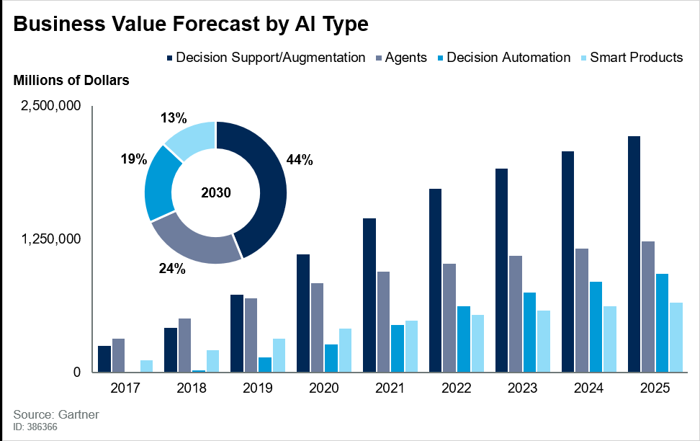
  The Development and Applications of Artificial Intelligence

Slide 31
  Will artificial intelligence replace human?
Analyzing more than 2,000 jobs in more than 800 occupations around the world, a report from McKinsey finds that around 50 percent of jobs worldwide can be automated by improving existing technologies.
The results of the Research Institute of Nomura in Japan and the University of Oxford in the United Kingdom show that artificial intelligence can replace 49% of human jobs in the future.
Data from U.S. consulting firm Opimas shows that AI will take the lead in disrupting the financial sector and then penetrate into all walks of life, and this pace is accelerating. By 2025, the use of AI is expected to reduce the number of employees in capital markets, including securities services, trading and settlement, asset management, private banking, and wealth management, by 230,000. Among them, the asset management industry has shrunk the most, and about 90,000 people will be replaced by machines.

Slide 32
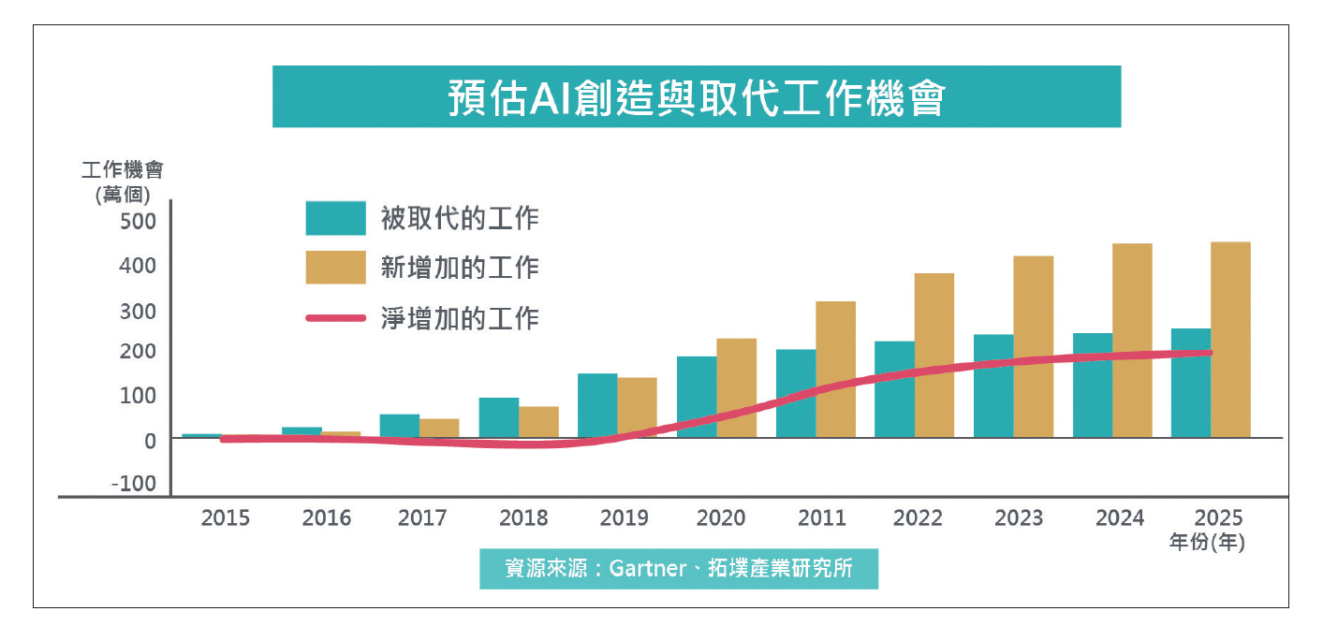
  Will artificial intelligence replace human?
E
estimated AI Creation and Replacement of Job Opportunity
Estimated AI Creation and Replacement of Job Opportunities
Job
Opportunities
(10 thousands)
Jobs being replace
Increase in jobs
Net increase in jobs
Source: Gartner, Topology Research Institute
Years (Year)

Slide 33
  The Advantages of Artificial Intelligence
It has high accuracy in calculations.
It has unimaginable high speed.
With amazingly fast memory and high-capacity storage.
As long as the original quality of the artificial intelligence machine is intact and the supply of resources for it is guaranteed, it can work continuously and tirelessly.
Artificial intelligence can also carry out long-term normal work in special places where human beings are difficult to move, such as the seabed, high altitude, high pressure, high temperature, nuclear pollution and other harsh conditions.

Slide 34
  The Advantages of Human Intelligence
It is creative as it discovers new things constantly, discovers and asks new questions.
The human brain can anticipate events and analyze them, guiding practices to change reality purposefully.
The human brain has a high degree of reliability.
Human intelligence creates artificial intelligence to serve human beings, and artificial intelligence cannot function without human instructions in the very first insance.

Slide 35
The future of human-robot collaboration
"Human-robot collaboration" refers to the work of humans in collaboration with intelligent machines or computers. In the future, "human-robot collaboration" will inevitably occur in our field of work, and the efficiency of artificial intelligence, such as diagnosing diseases, translating, and providing customer responses, can completely change the way we work, and can assist and expand people's capabilities. Through this collaborative intelligence, humans and AI can enhance and complement each other, and the advantages of both sides include human leadership, teamwork, creativity, and social skills; artificial intelligence has speed, scale scalability, and quantitative ability. And these two aspects of the ability are the future of the enterprise needs.

Slide 36
  Challenges Faced by the
  Development of Artificial Intelligence
Artificial intelligence's machine learning techniques collect a lot of data for learning, but if the data collected is biased, or the algorithm is determined by only a few specific people, the process is not transparent enough, and there is no accountability, then it will trigger potential moral hazard.
Biased AI not only affects our daily affairs, but is also likely to be treated unequally by using or labeling without our noticing.

Slide 37
  Q&A

Slide 38

  The relationship between AI and Big Data
If big data is an oil field, AI is an oil refinery, and most of the achievements made so far in the development of artificial intelligence are closely related to big data. Artificial intelligence is inseparable from machine learning, from which, through a series of processing steps such as data acquisition, processing, analysis, etc., we obtain valuable insights from massive data from various industries.
For example, the progress of Go games, computer vision, commercial precision marketing, unmanned autonomous driving, etc., all come from the collection and training of a large amount of data.
This Photo by Unknown Author is licensed under CC BY-SA

Slide 39

  What is an AI algorithm?
In machine learning, an algorithm is a set of rules or instructions provided to an AI to help it learn on its own. Well-built algorithms are the backbone of artificial intelligence.
Think of the algorithm as giving a robot a recipe for making pancakes. The robot will make pancakes according to this recipe.
This Photo by Unknown Author is licensed under CC BY-NC

Slide 40
  Do I need to be proficient in
  Python before learning AI?
No! Not at all. In fact, you don't need to be proficient in Python or any other programming language to start reading AI books. However, you still need to have some key knowledge in computer science, including:
Preliminary programming concepts
Algorithms/data structures
mathematics

Slide 41
  Summary

Slide 42
  Summary
Artificial intelligence has made significant progress after more than 60 years of development, but it is still in its infancy overall.
Artificial intelligence not only has a huge space for theoretical and technological innovation, but also has broad application prospects.
High technology itself is not angelic and devilish, and artificial intelligence is no different. Whether the double-edged sword of artificial intelligence is an angel or a devil depends on the human being itself.
We should take precautions and form a synergy to ensure the positive effects of artificial intelligence and to ensure that artificial intelligence benefits mankind.

Slide 43
  Thank You

