Slide 1
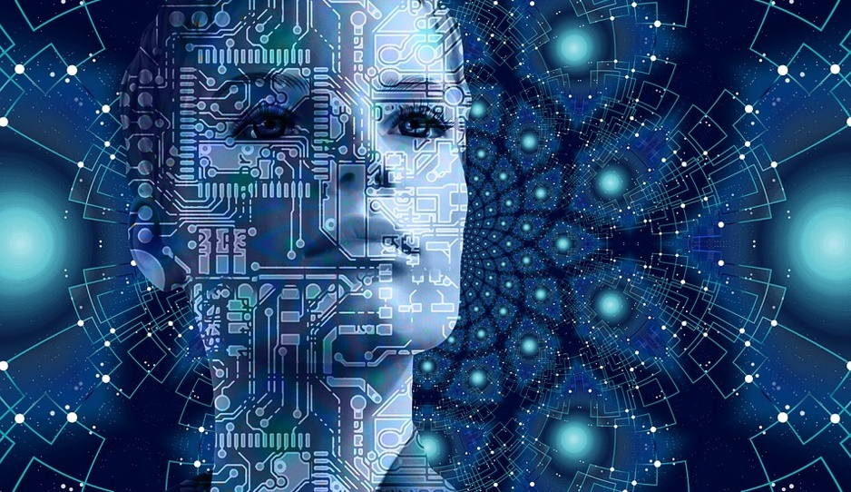
Session 2:
Computer Vision
This Photo by Unknown Author is licensed under CC BY-SA-NC

Slide 2
Contents
  1. Introduction to Computer Vision
  2. Major challenges in computer vision
  3. ImageNet visual database
  4. Convolutional Neural Networks (CNNs)
  5. Face recognition systems

Slide 3
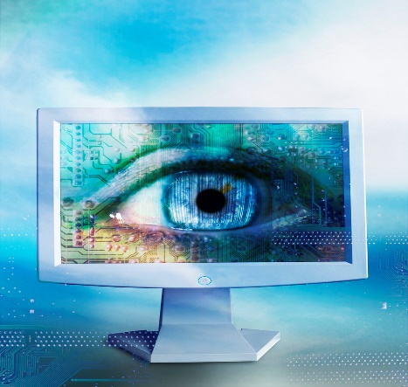
(1) Computer Vision
Computer vision is a category of computer science that focuses on enabling computers to recognize and understand people and objects in images and films. Computer vision, like other types of AI, can try to perform and automate work that mimics human capabilities. In this case, computer vision attempts to mimic how human vision works, as well as how humans interpret what they see.
This Photo by Unknown Author is licensed under CC BY

Slide 4
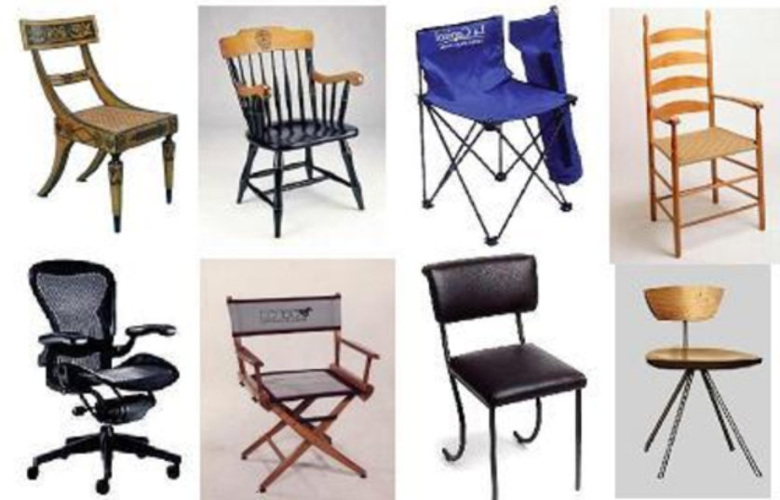
(2) Major Challenges in Computer Vision
Intra-Class Variation
Variation between images of the same class.

Slide 5
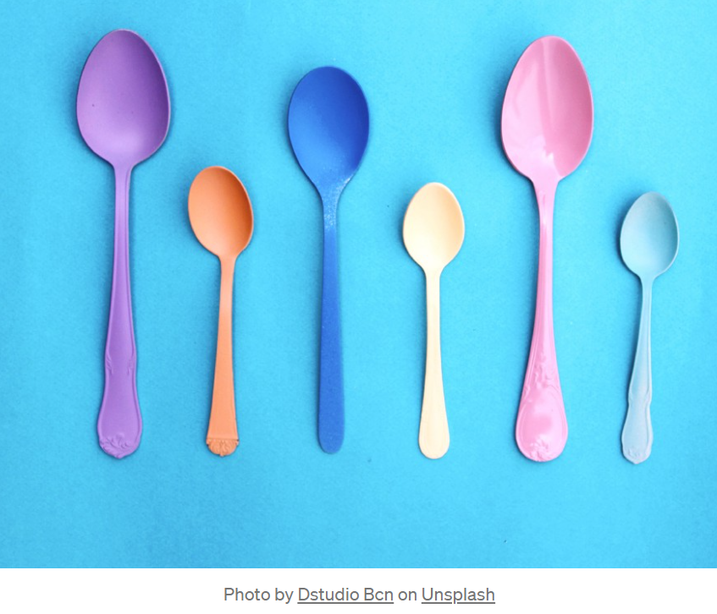
Major Challenges in Computer Vision
Scale Variation
Common in image classification. Images in the same class with different sizes.

Slide 6
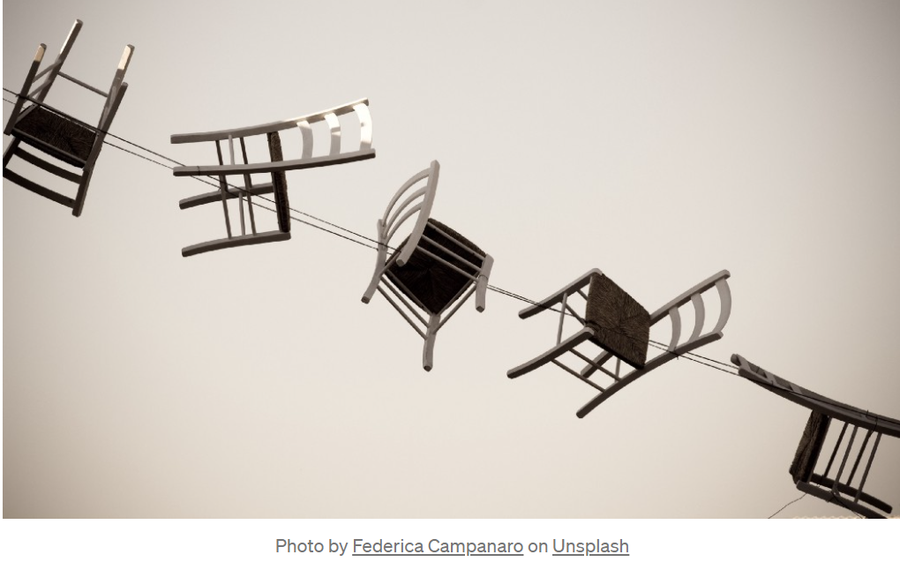
Major Challenges in Computer Vision
View-Point Variation
An object can be oriented/rotated in multiple dimensions, which is related to how the object is shot and captured in the image.

Slide 7

Major Challenges in Computer Vision
Occlusion
There are a lot of objects in the image that we want to classify that can't be fully viewed. A large part is hidden behind other objects.

Slide 8
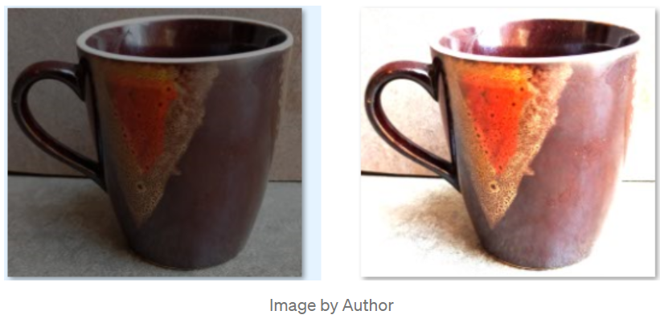
Major Challenges in Computer Vision
Illumination
Our image classification should also be able to handle changes in lighting.

Slide 9
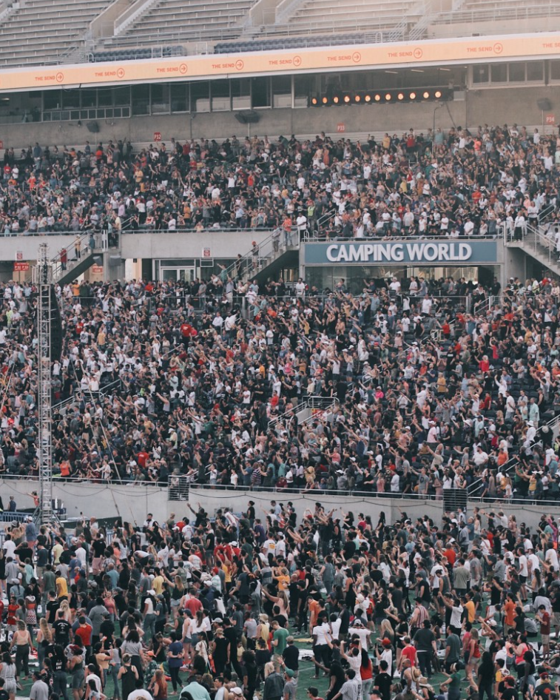

Major Challenges in Computer Vision
Background Clutter
There are many objects in the image, and it is difficult for the observer to find a particular object. These images are very "noisy".

Slide 10
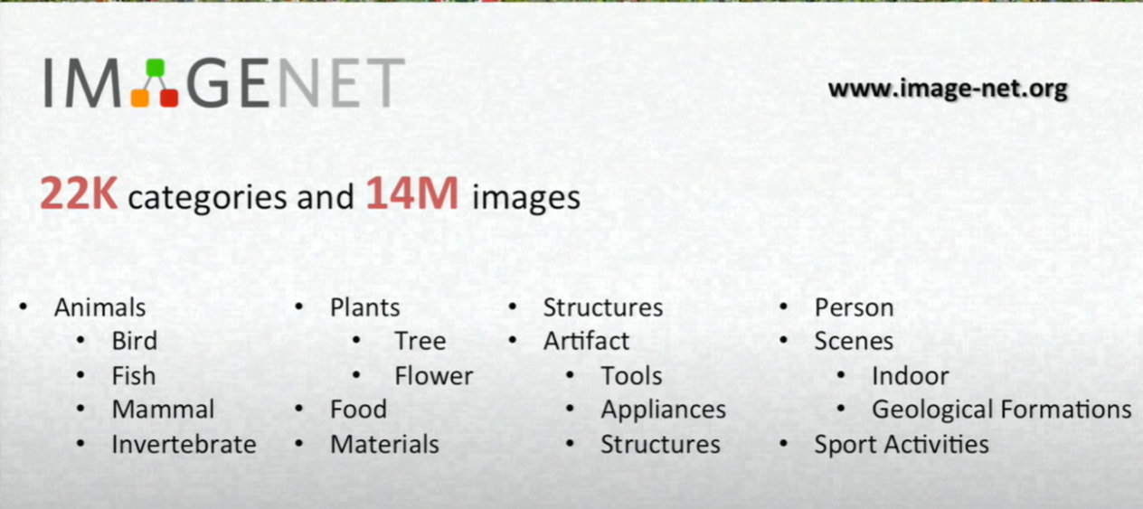
(3) ImageNet: A Dataset That Has Changed the Development of AI
The ImageNet project is a large visual database for visual object recognition software research. The project has manually annotated more than 14 million images. Feifei Li, a professor of computer science at Stanford University, has been working on ImageNet's ideas since 2006. While most AI research focuses on models and algorithms, Li hopes to expand and improve the data that can be used to train AI algorithms.

Slide 11
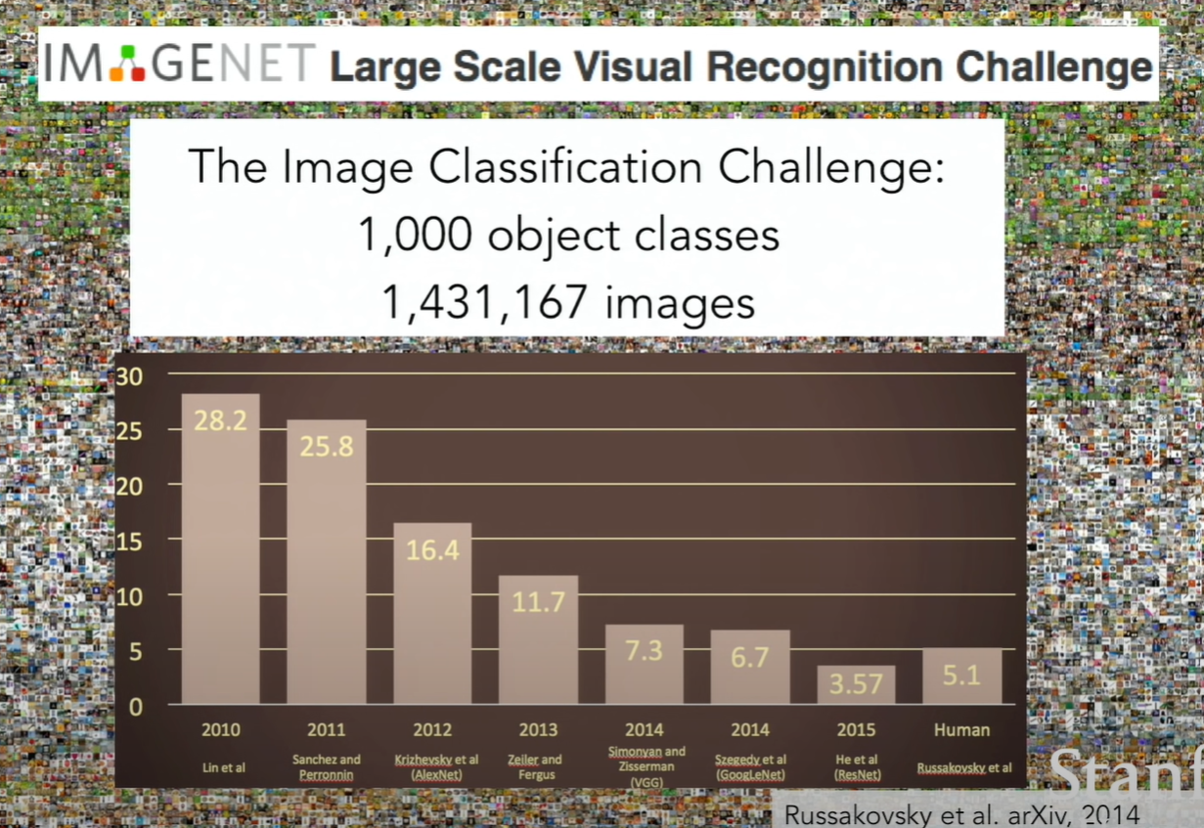

Slide 12
(4) Convolutional Neural Networks (CNNs)
Convolutional Neural Networks, referred to as CNNs, are very powerful in image recognition. Many image recognition models are based on the CNN architectures.
Alex Krizhevsky won the 2012 ImageNet Challenge with CNNs. He shocked the world at the time by dropping the classification error record from 26% to 16%. Since then, a large number of companies have started using deep learning as the core of their services. E.g., Facebook uses neural networks for automatic labeling algorithms, Google uses it for image search, and Amazon uses it for product recommendations.

Slide 13
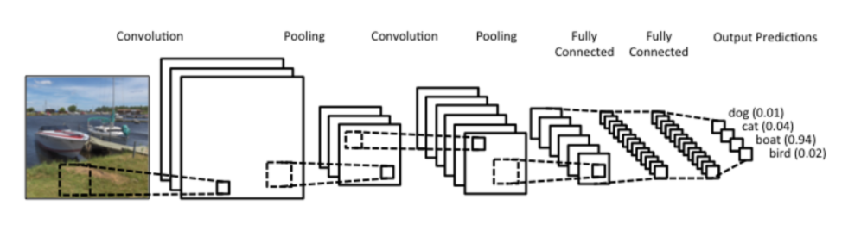
(4) Convolutional Neural Networks (CNNs)
What CNNs do the best is the processing of pictures. It is inspired by the human visual nervous system.
They can effectively reduce the size of large data images into small data volumes.
They can effectively retain the characteristics of the picture, in line with the principle of picture processing.
At present, CNNs have been widely used, such as: in face recognition, automatic driving and in many other fields.

Slide 14
Basic Principles of CNNs
A CNN consists of three main parts:
Convolutional layer reduces the images into a form which is easier to process, without losing features which are critical for getting a good prediction.
Pooling Layer is responsible for reducing the spatial size of the Convolved Feature. This is to decrease the computational power required to process the data through dimensionality reduction.
Fully connected layer connects every input neuron to every output neuron.

Slide 15
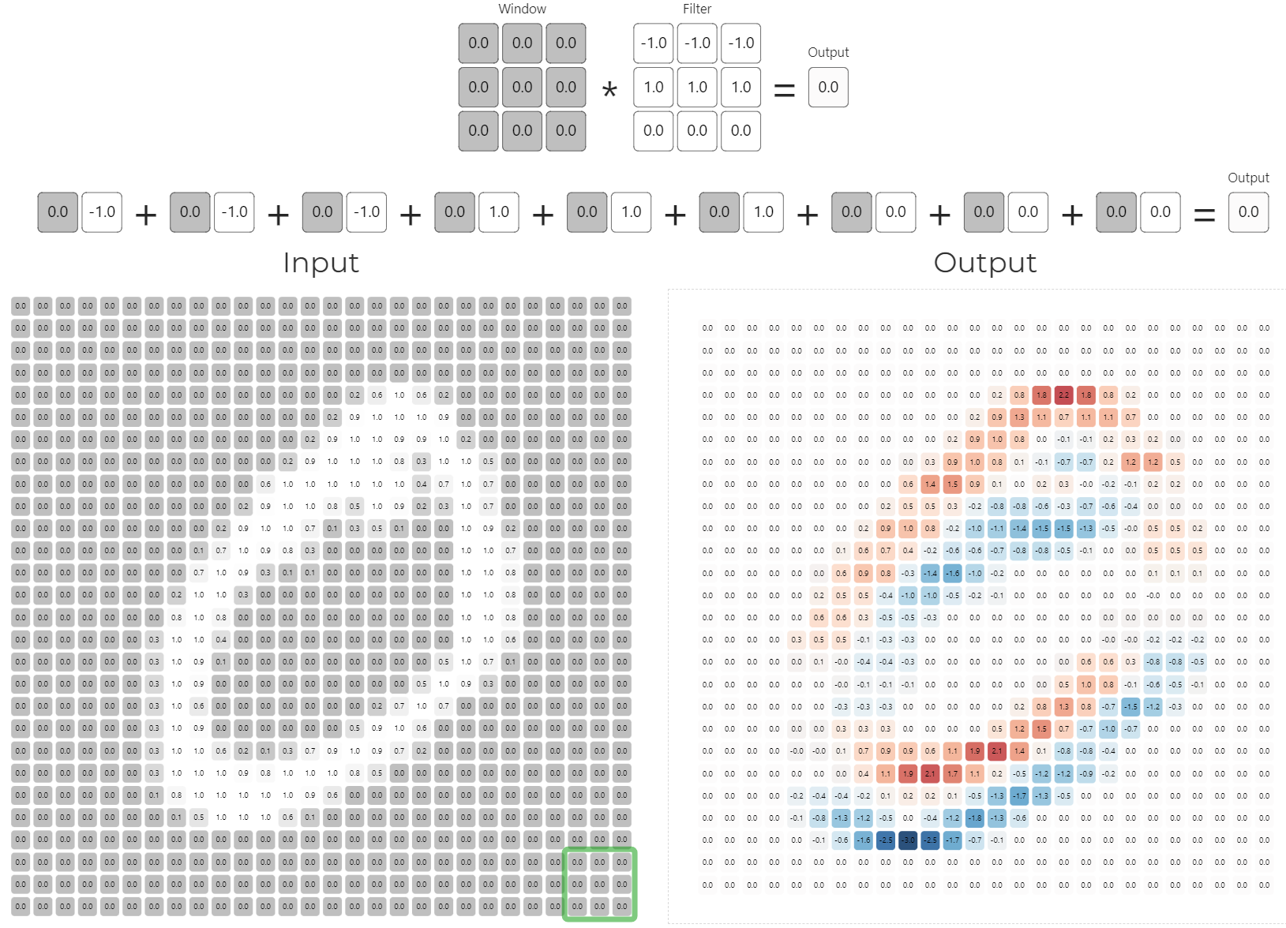
Demo 1: How Convolutional Layer works
We can use this interactive tool to understand the operations of the convolutional layer.
https://deeplizard.com/resource/pavq7noze2

Slide 16
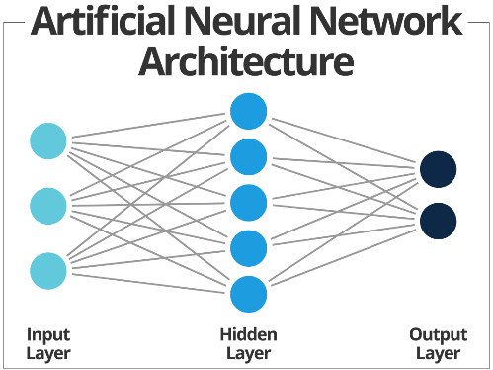
Neural Networks
Neural networks are a series of algorithms that mimic the operations of a human brain to recognize relationships between vast amounts of data.

Slide 17
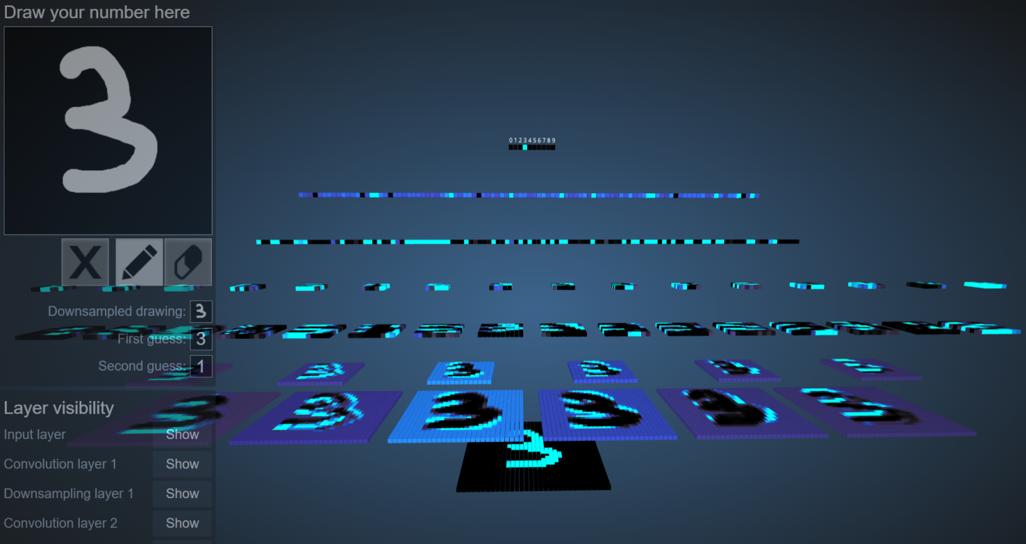
Demo 2: 3D Visualization of CNNs
We can use this interactive visualization neural network tool to further understand CNNs. We write digits by hand with the drawing board, and then observe how CNNs distinguish these digits.
https://www.cs.ryerson.ca/~aharley/vis/

Slide 18
What Problems Can CNNs Solve?
Before the advent of CNNs, images were a challenge for artificial intelligence for two main reasons:
The amount of data that images need to process was too large, resulting in high costs and low efficiency.
It was difficult to retain the original features of the image in the process of digitization, resulting in a low accuracy of image processing.

Slide 19
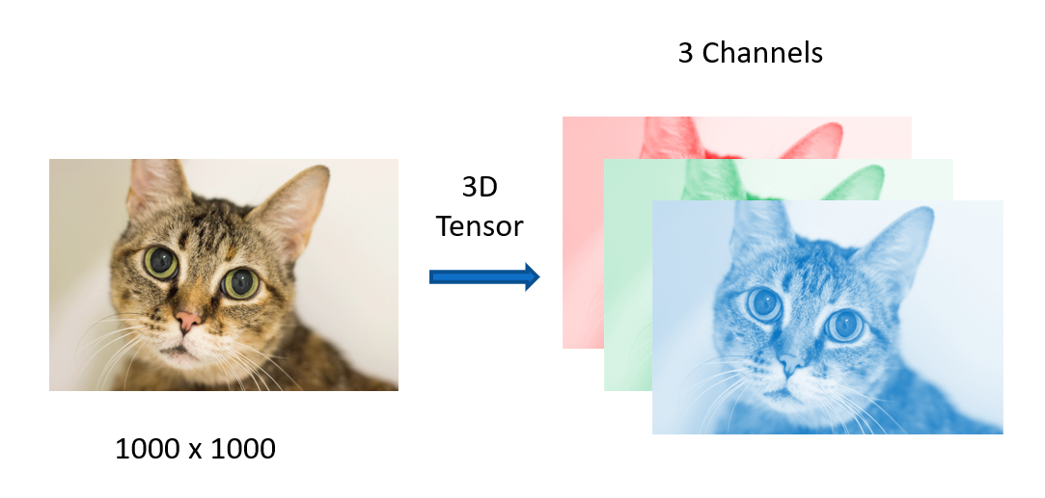
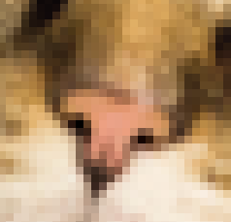
Excessive Amounts of Data Need to Be Processed
Images are made of pixels, and each pixel is made of colors. If we are to process a 1000×1000 pixel image, each with RGB, 3 parameters to represent color information, we would need to process 3 million parameters!
CNNs simplify this complex problem by dimensionality reduction, that is, reducing a large number of parameters into a small number of parameters, and then process it, and more importantly, in most scenarios, this dimensionality reduction does not affect the results.

Slide 20
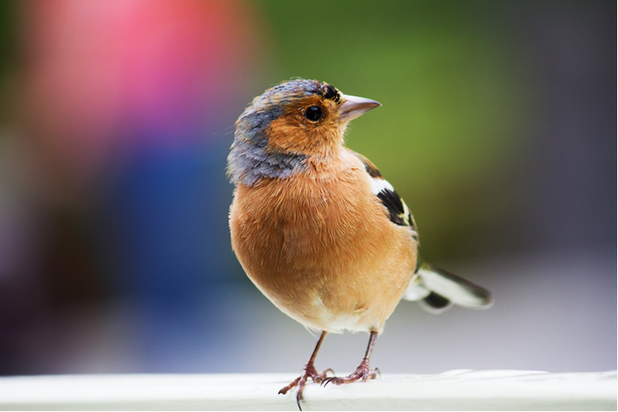
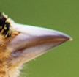
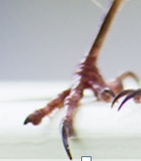
Retain the Features of Image

Slide 21
Retain the Features of Image
CNNs retain the characteristics (or features) of the image so that the object can still be effectively recognized when its image is flipped, is rotated, or changes its position.

Slide 22

Retain the Features of Image

Slide 23
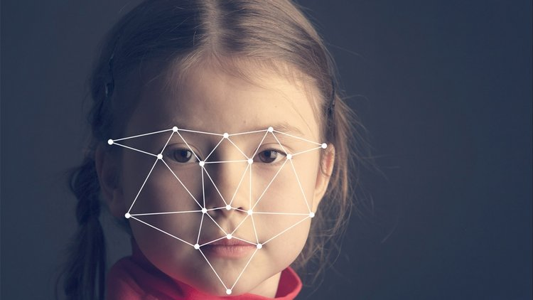
(5) Facial recognition
Facial recognition refers to the use of cameras to collect images or videos containing faces, and then use advanced biometrics in artificial intelligence to automatically recognize faces in images or videos.
This Photo by Unknown Author is licensed under CC BY

Slide 24
Human Vision VS Computer Vision
Imprint the visitor's image with both eyes
Remember the main features on this face
Find the location of the face
Searching the most similar face in memory based on the features. If this fails, that person is a visitor.
Image Capturing
Feature Extraction
Data Processing
Pattern Matching

Slide 25
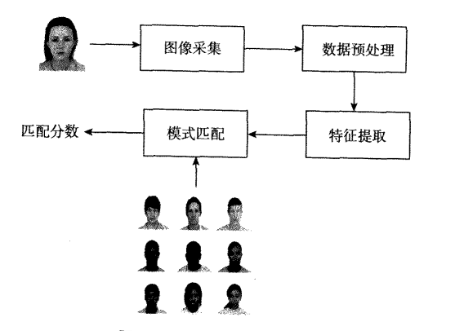
Facial recognition system
Image Capturing: An image containing an area of a person's face is captured by optical devices. Equipment includes cameras, high-definition cameras, surveillance cameras, etc.
Data Processing: Pre-processing of the collected images, mainly including face positioning and normalization:
  Face Positioning: Find the area of the face in the picture
  Normalization: Adjust the positioned face map to reduce the influence of interference factors such as lighting, position, and posture.

Slide 26
Facial recognition system
Feature Extraction: Extracts typical features with strong expression ability and distinguishing ability. There may be many of these features, and we call them feature vectors: local features of each part of the face (eye, mouth, nose); overall features such as contours and grayscale.
Pattern Matching: Compare different images based on feature vectors. A matching score is given in the process, representing how similar two graphs are. A match score is used to complete an identity confirmation or identifying a goal.

Slide 27
How Facial Recognition Balances Privacy (1)
In recent years, face recognition technology has caused a lot of controversy. With the increasing popularity of technology, people are paying more and more attention to the privacy and protection of data. Many people use face recognition technology every day to unlock mobile phones, authorize payments, enter and exit offices, etc., and even airport security inspection is beginning to apply face recognition technology.
However, people are also beginning to question the morality, accuracy and problems that facial recognition technology may cause. Some U.S. cities have even begun to ban the technology, even the police will not be allowed to use it. Some British lawmakers have proposed legislation before application, and the European Union is also seeking ways to restrict the "indiscriminate" use of facial recognition technology.

Slide 28
How Facial Recognition Balances Privacy (2)
In fact, all new technologies that are widely used and have a profound impact on life will face similar problems. The accuracy of the technology, the need to reach consensus with stakeholders when applying it, legal responsibilities, application ethics, etc., are all of concern, and there is a need to find a balance that ensures the legal application of technology while respecting the rights of individuals.
However, artificial intelligence and deep learning will not necessarily become tools that invade personal privacy, depending purely on how the system is designed and used. For example, in the occasion of crowd gathering, only need to detect the face, do not need to confirm or store the appearance of individuals, you can count the number of people present, convenient to control the flow of people. Even face recognition has a very diverse machine learning methods, such as the Face ID function of Apple's mobile phone, and Apple itself does not have a central database to store users' photos.

Slide 29
How Facial Recognition Balances Privacy (3)
The artificial intelligence technology behind face recognition, in fact, has a wider range of applications, such as face analysis, which can analyze images and videos, extract features to identify gender, age, and even body mass index, and the technology has been used to measure heartbeat, blood pressure, and even detect the first signs of diabetes, heart disease or dementia. At present, some insurance companies are using facial analysis to simplify the calculation of policy amounts.
Source: https://www.hkcs.org.hk/%E4%BA%BA%E8%87%89%E8%BE%A8%E8%AD%98%E6%87%89%E7%94%A8%E3%80%80%E5%A6%82%E4%BD%95%E5%B9%B3%E8%A1%A1%E7%A7%81%E9%9A%B1%EF%BC%9F/

Slide 30

Demo 3: Teachable Machine
Teachable Machine is a web tool provided by Google that allows anyone to simply train machine learning models for websites and applications without programming experience.
Source: https://teachablemachine.withgoogle.com/

Slide 31
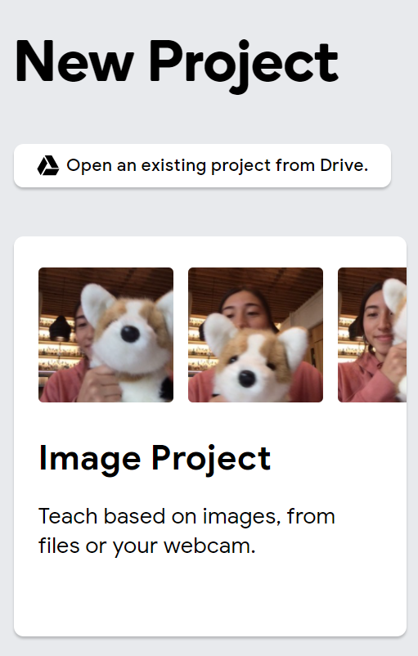
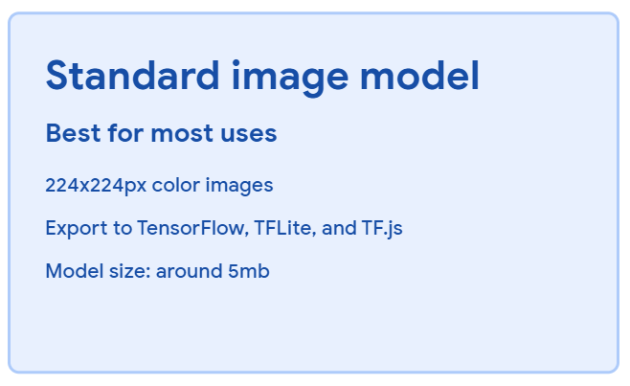
Teachable Machine: Machine learning
Select Image Project
Select the Standard image model

Slide 32

Teachable Machine: Machine learning
3. Complete the following three steps:
  Collect data: After changing the appropriate name (Class), use the camera to take a real-time picture of the person, or upload your own saved picture.
  Learn: Press Train Model to start learning.
  Preview

Slide 33
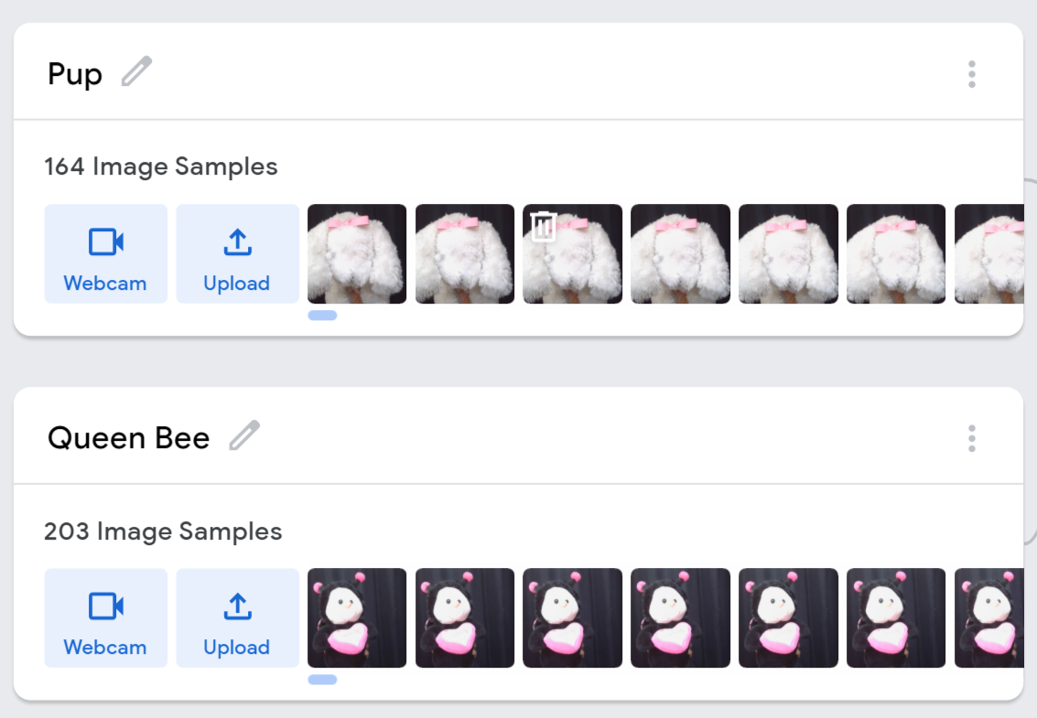
Teachable Machine: Machine learning

Slide 34

Demo 4: PictoBlox
PictoBlox is based on Scratch and contains a number of AI learning functions, which are especially suitable for students from the fifth grade to the middle school to learn and use. Even without any technical knowledge, students can write programs through a simple and easy-to-use graphical interface.
https://thestempedia.com/product/pictoblox/

Slide 35

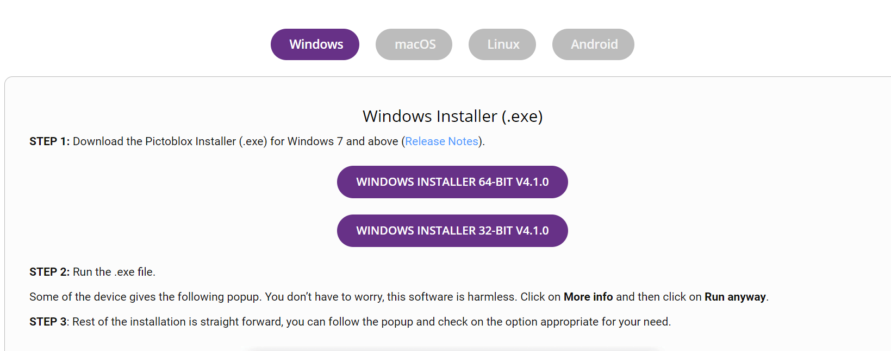

PictoBlox – Installation
1
Download from the following link: https://thestempedia.com/product/pictoblox/
Select the type of OS of your computer and install the software.
Register for use
3
2

Slide 36




PictoBlox – Registration

Slide 37
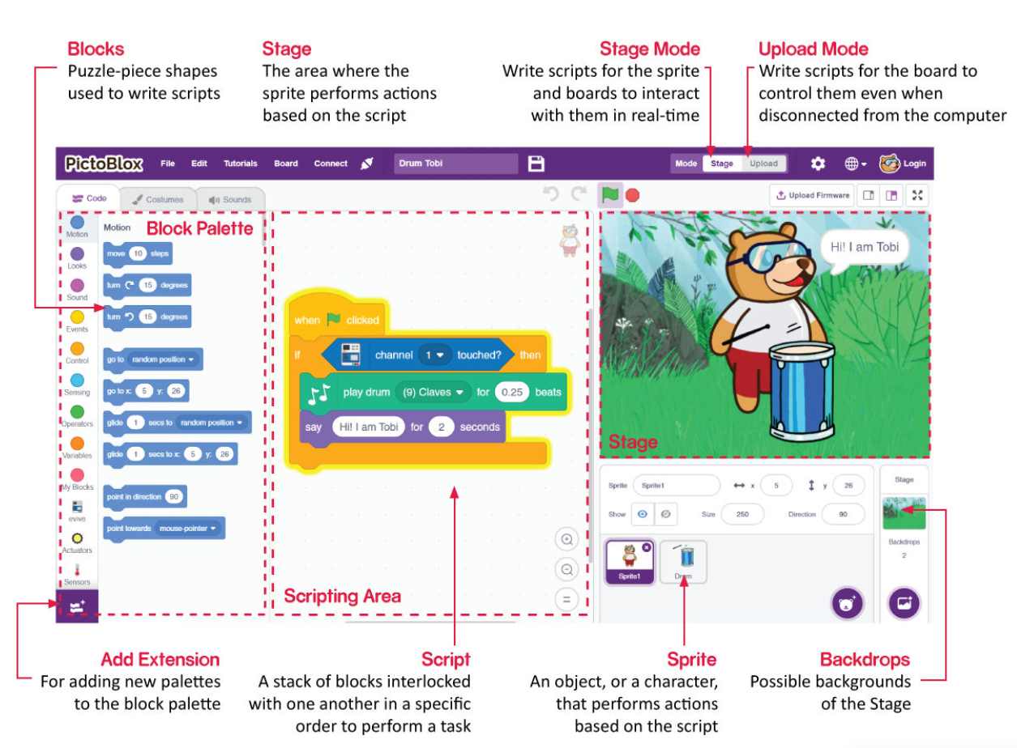
PictoBlox – interface

Slide 38
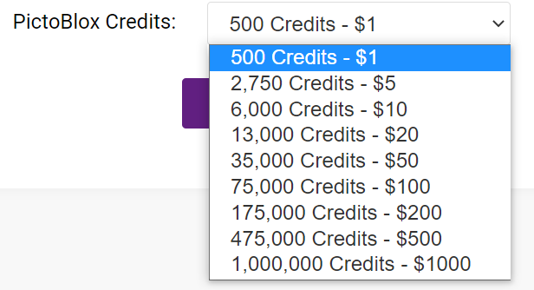
PictoBlox – Credits
PictoBlox is not an completely free software. We can use the points to operate certain functions in PictoBlox, such as text recognition, speech recognition, etc.
When you sign up with PictoBlox, you will earn 1000 points in your account. If you need more points, you need to buy, here is the purchase of points in US dollars for the exchange table:

Slide 39


PictoBlox – Human Face Recognition
After completing the learning at Teachable Machine, export the model.
Then select “Upload my model”.

Slide 40

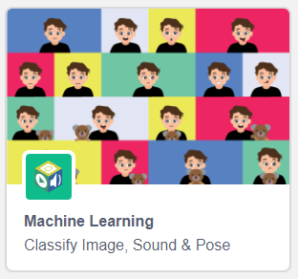
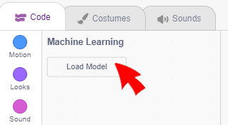
PictoBlox – Human Face Recognition
Copy the link.
Add Machine Learning into Pictoblox.
Select "Load Model“.

Slide 41

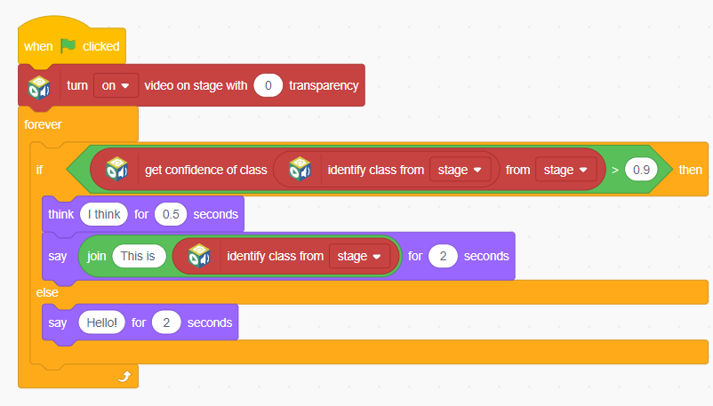
PictoBlox – Human Face Recognition
Paste the link and select "Load Model“.
You can use the example on the right creatively.

Slide 42

  Thank You

