Slide 1

Session 3: Hear Your Voice

Slide 2
Contents:
Introduction to Speech Recognition
The Generation of Speech
Speech Recognition Technology
The Basic Method of Speaker Recognition and Speech Synthesis
Understanding the Complexity of Human Language
Text-based Natural Language Understanding
Machine Translation Technology
Applications of Natural Language Understanding in Search Engines and Intelligent Recommender Systems

Slide 3
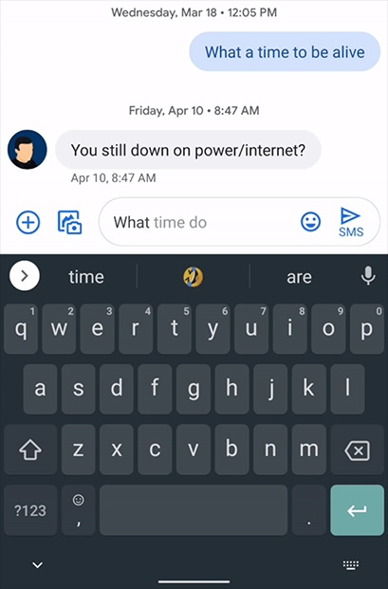
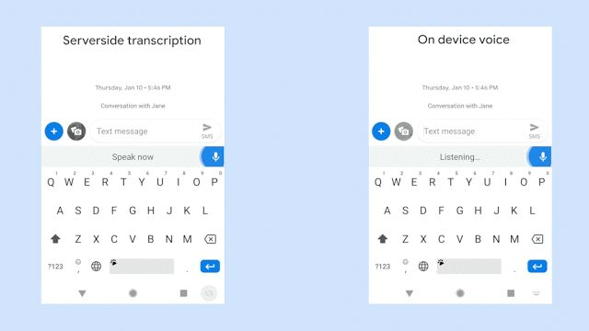
Introduction to Speech Recognition
Google Gboard in WhatsApp

Slide 4
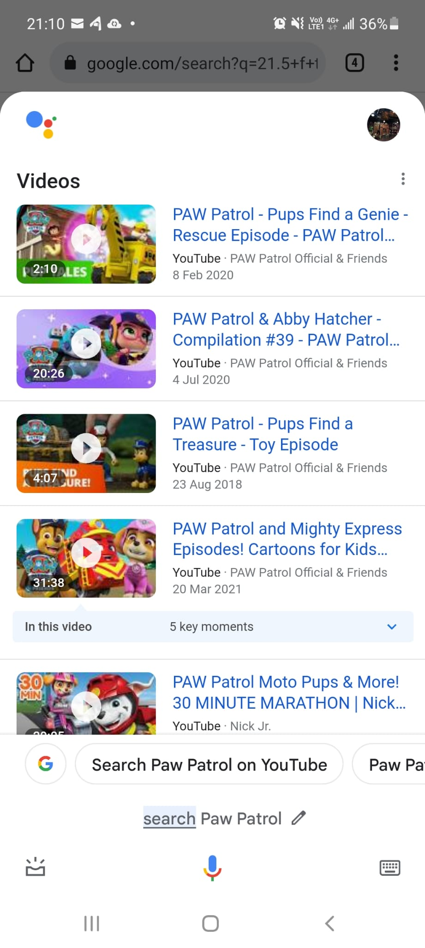
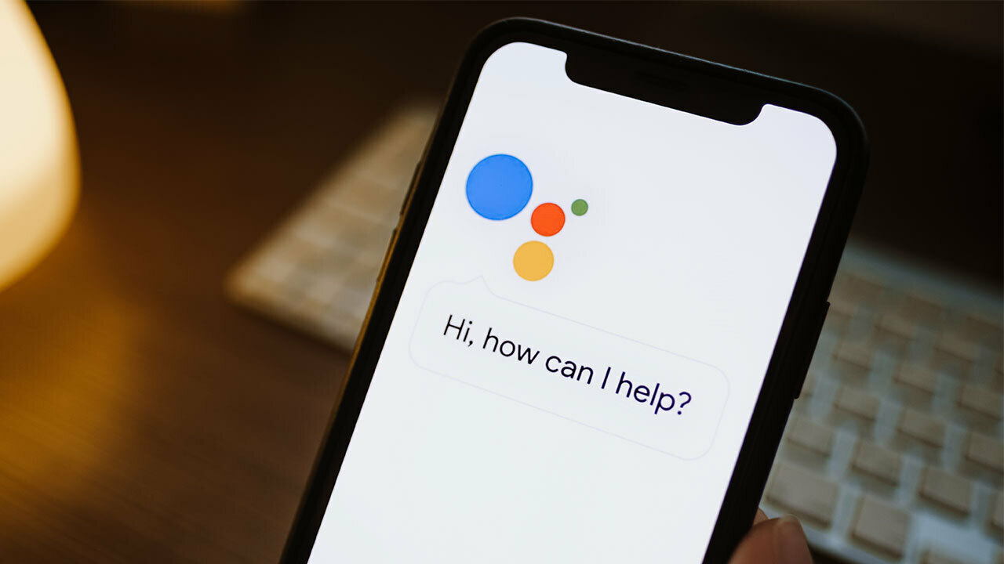
Introduction to Speech Recognition
Google Assistant

Slide 5
Introduction to Speech Recognition
Amazon Alexa Voice Control Assistant
Voice command
Voice Q&A

Slide 6
Introduction to Speech Recognition –
What is Speech Recognition?
In biometrics, a popular field in artificial intelligence (AI), speech recognition may have gradually entered everyone's sight recently. Because of the popularity of the Internet of Things (IoTs) industry, voice recognition has become a technology that everyone is vigorously promoting.
Speech recognition, also known as Automatic Speech Recognition (ASR), computer speech recognition, or speech-to-text, is a functional force that enables programs to process human speech in writing. While often confused with voice recognition, speech recognition focuses on converting from spoken to textual forms, while voice recognition attempts to recognize the voice of an individual user.

Slide 7
What problems does speech recognition solve?
Common speech recognition applications, conceptually, are trained AI models to detect sound and make the next action.
For example: transmitting a text message, or semantic understanding and then turning into voice commands to control intelligent devices, making life more convenient.

Slide 8
Introduction to Speech Recognition
Accumulation of Knowledge
Template Matching
Statistical Models
Machine Learning
Deep Learning
1930-1950
1950-1980
1980-2000
2000-2010
2011 to present
- Signal study
Filter Bank
DTW
LPC
- GMM-HMM
model training
from real data
- DNN
Statistical model: It is to build a model for each phoneme, and determine the model parameters by counting multiple pronunciation samples of each phoneme
Hidden Markov model (GMM-HMM)
  A large amount of real data is used in model training to improve the practicality of the system
  Machine learning technology is widely used, and the GMM-HMM system is maximized
With the advent of the era of big data, the processing power of GMM-HMM models is limited. Acoustic modeling using Deep Neural Networks (DNN) has only a 23% phoneme error rate, which is superior to the GMM-HMM model. DNN became the mainstream model of speech recognition

Slide 9
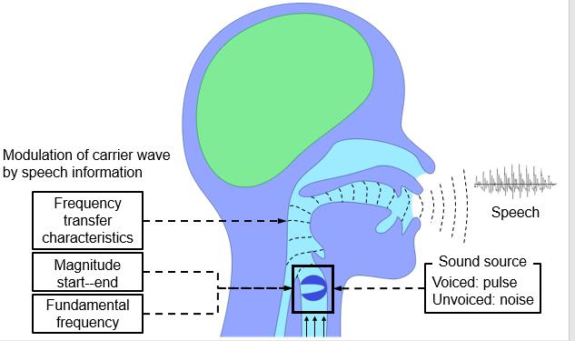
The Generation of Speech
Air enters the lungs through breathing, at which point no sound is generally produced.
Air is discharged from the lungs through the trachea to form an air stream that passes through the vocal cords.
Vibrations of the vocal cords cause changes in airflow tightness and resonate in the mouth and nasal cavity, which causes the dense pattern of airflow to change.
Dense patterns radiate from the lips, producing the speech we hear.
More attention should be paid to vocal modulation when analyzing pronunciation content, and more attention should be paid to changes in vocal cord vibration when analyzing changes in mood.

Slide 10
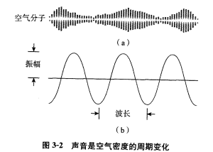
The Generation of Voice and Recording of Sound
Essentially, speech is a periodic change in the dense phases of the air, propagating in the air in the form of longitudinal waves.
https://www.youtube.com/watch?v=BoeDI-YkzI0

Slide 11
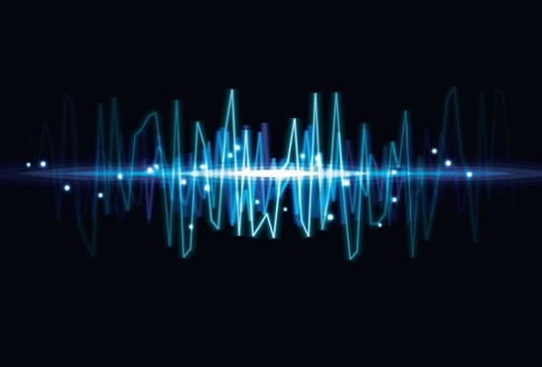
The Generation of Voice and Recording of Sound
Record sound = record changes in air pressure
Sampling: Record the air density every very short time (e.g., 1/16000th of a second) to record the voice signal at that point.
Each record value is called a sample point
The number of samples in a second is called the sampling frequency
Expressing the density value as a function of time results in a waveform plot of the speech signal.

Slide 12
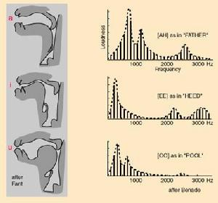
The Generation of Speech and Its Different Sounds
Speech signals of different pronunciation contents have different formant positions, widths, intensities, and morphologies, by which we can distinguish different pronunciations.

Slide 13
The Generation and Perception of Speech
Speech signals contain extremely complex information such as pronunciation content, speaker identity, speaking style, goals and motivations, it is obviously extremely difficult for a computer to parse such complex and diverse information from a pile of sample points.
Speech signals contain a lot of randomness, unconscious changes in the pronunciation process (such as differences in air delivery and tongue position), external environmental noise and differences in sound acquisition devices → increase the difficulty of the computer to extract speech information.

Slide 14
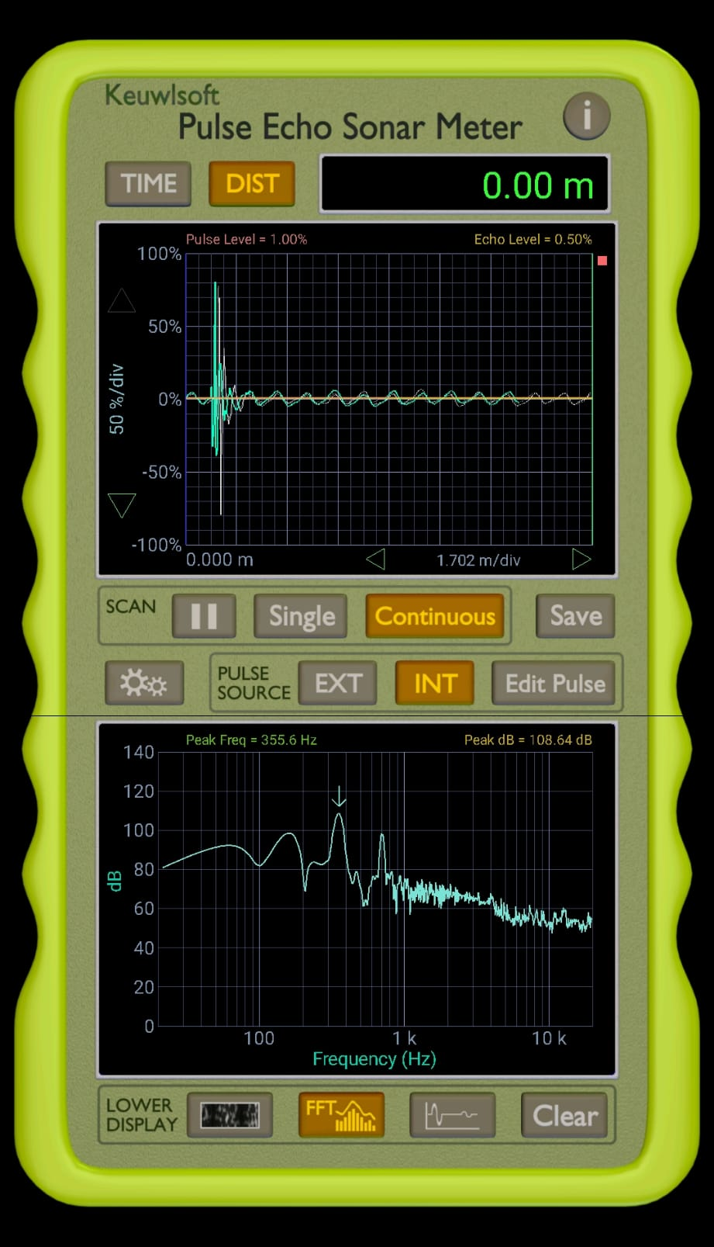
The Generation of Speech (Demo)
Use the audio output to generate sound pulses, and then detect echoes on the microphone. Echo signals can be visualized in a map, Fourier transform, or simply as a time series waveform. Ideal for investigating/ demonstrating acoustic principles.
• Sampling frequency 44.1 kHz
• Sampling duration 0.001 s to 5 s
聲音
Downloaded from Google Play : Pulse Echo Sonar Meter

Slide 15
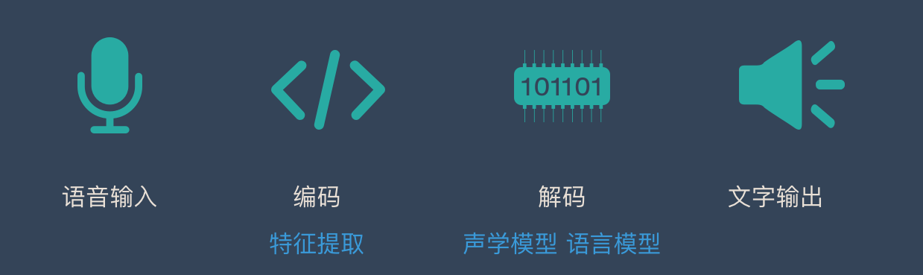
Speech Recognition Technology
Steps:
Step 1
Step 2
Steps 3 & 4
Step 5
Voice input
Acoustic feature extraction
Acoustic model
Language model and language processing
Text output
It is mainly composed of two parts: feature extraction and pattern matching.
Pattern matching: a sequence matching question / a search process → decoding
Decoding requires the use of acoustic models (how each phoneme is pronounced) and language models (describing the laws of word combinations).

Slide 16
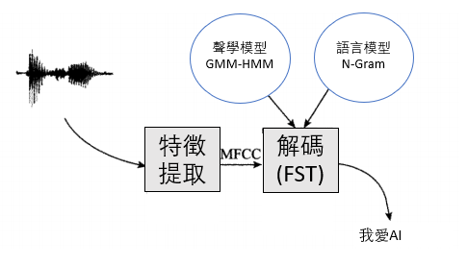
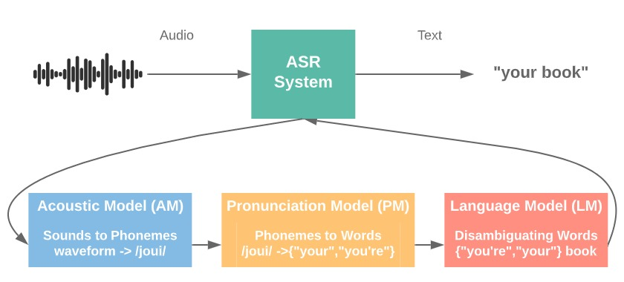
Traditional System Configuration of Speech Recognition Technology
GMM-HMM
N-Gram
Chinese Identification
English recognition

Slide 17
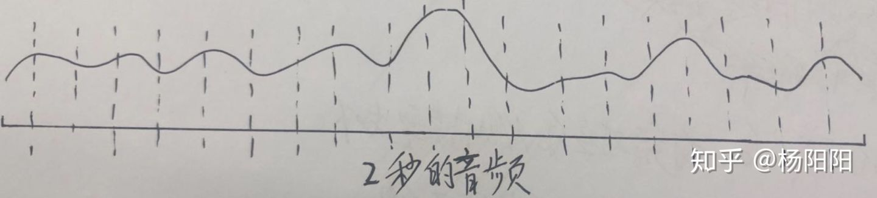
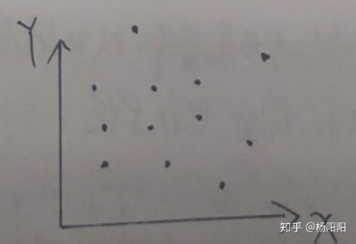
MFCC Feature Extraction for Speech Recognition Technology
Example: We divide the audio of the above 2 seconds into frames, taking the frame length of 100ms and the frame shift of 100ms as an example, so that the above audio is divided into 20 frames.
Features that better describe the content of the pronunciation can be extracted
Mel Frequency Cesptrum Coefficient (MFCC) - this feature mainly describes the vocal channel information related to the pronunciation content, and simulates the auditory characteristics of the human ear, increasing the sensitivity to low-band information.

Slide 18
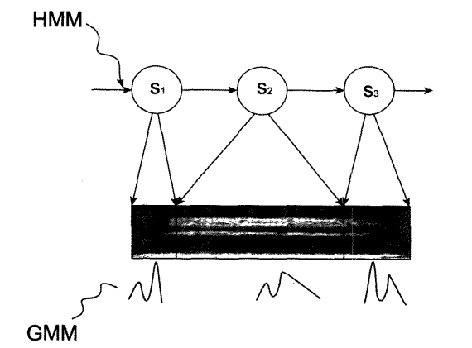
GMM-HMM Acoustic Model of Speech Recognition Technology
Acoustic model describes the pronunciation process of a phoneme.
GMM-HMM: Probabilistic model
- There are two parts:
  An HMM model that describes the dynamic characteristics of pronunciation
    Dynamic characteristics: the evolution of the development of voice signals in chronological order.
  A GMM model that describes short-term static characteristics
    Static characteristics: the distribution law of voice signals in a short-term stationary state.

Slide 19
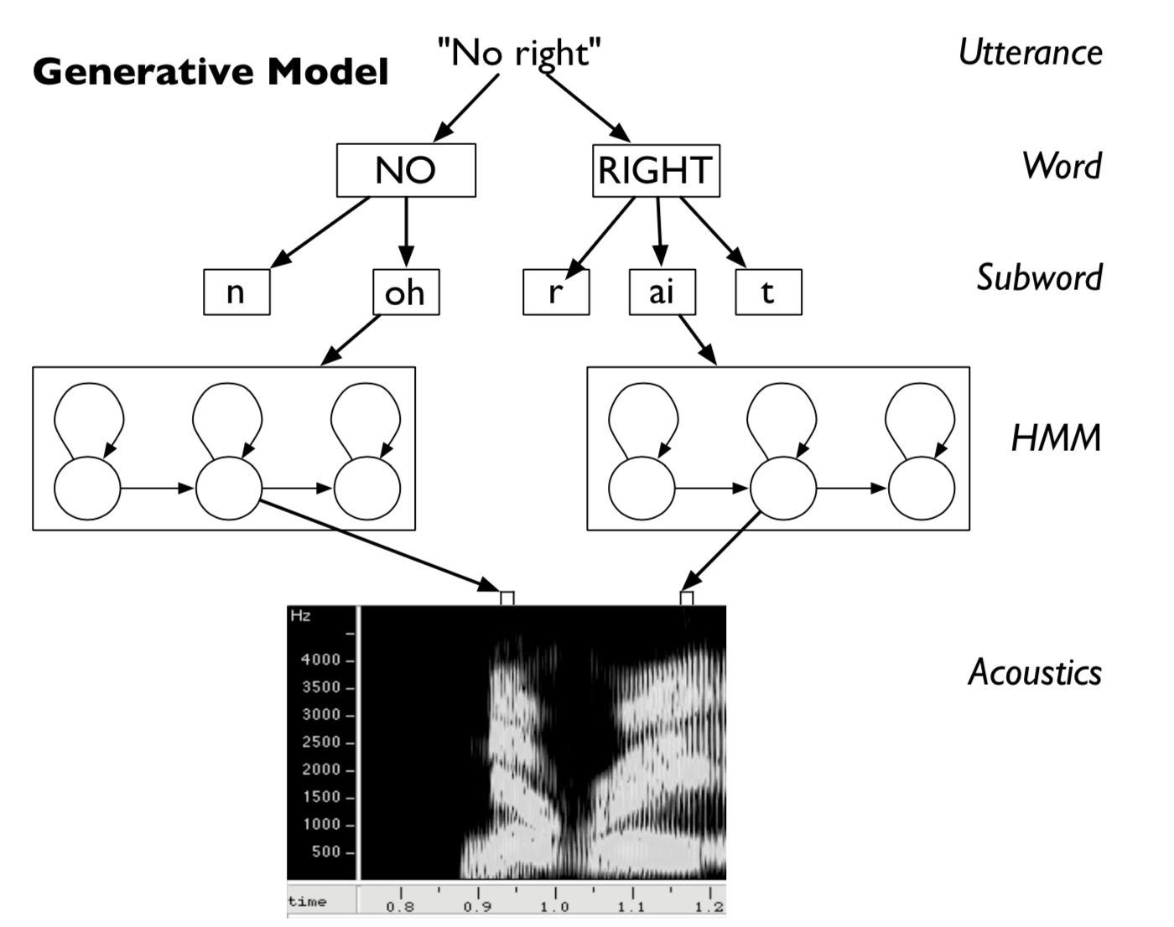
Speech Generation Process of GMM-HMM Model of Speech Recognition Technology
The HMM model abstracts the pronunciation process into a sequence of states, moving from the initial state to the end state, with each transfer corresponding to a transition probability.
The three-state HMM model contains three states, corresponding to "start pronunciation", "smooth pronunciation" and "pronunciation end" in the pronunciation process.

Slide 20
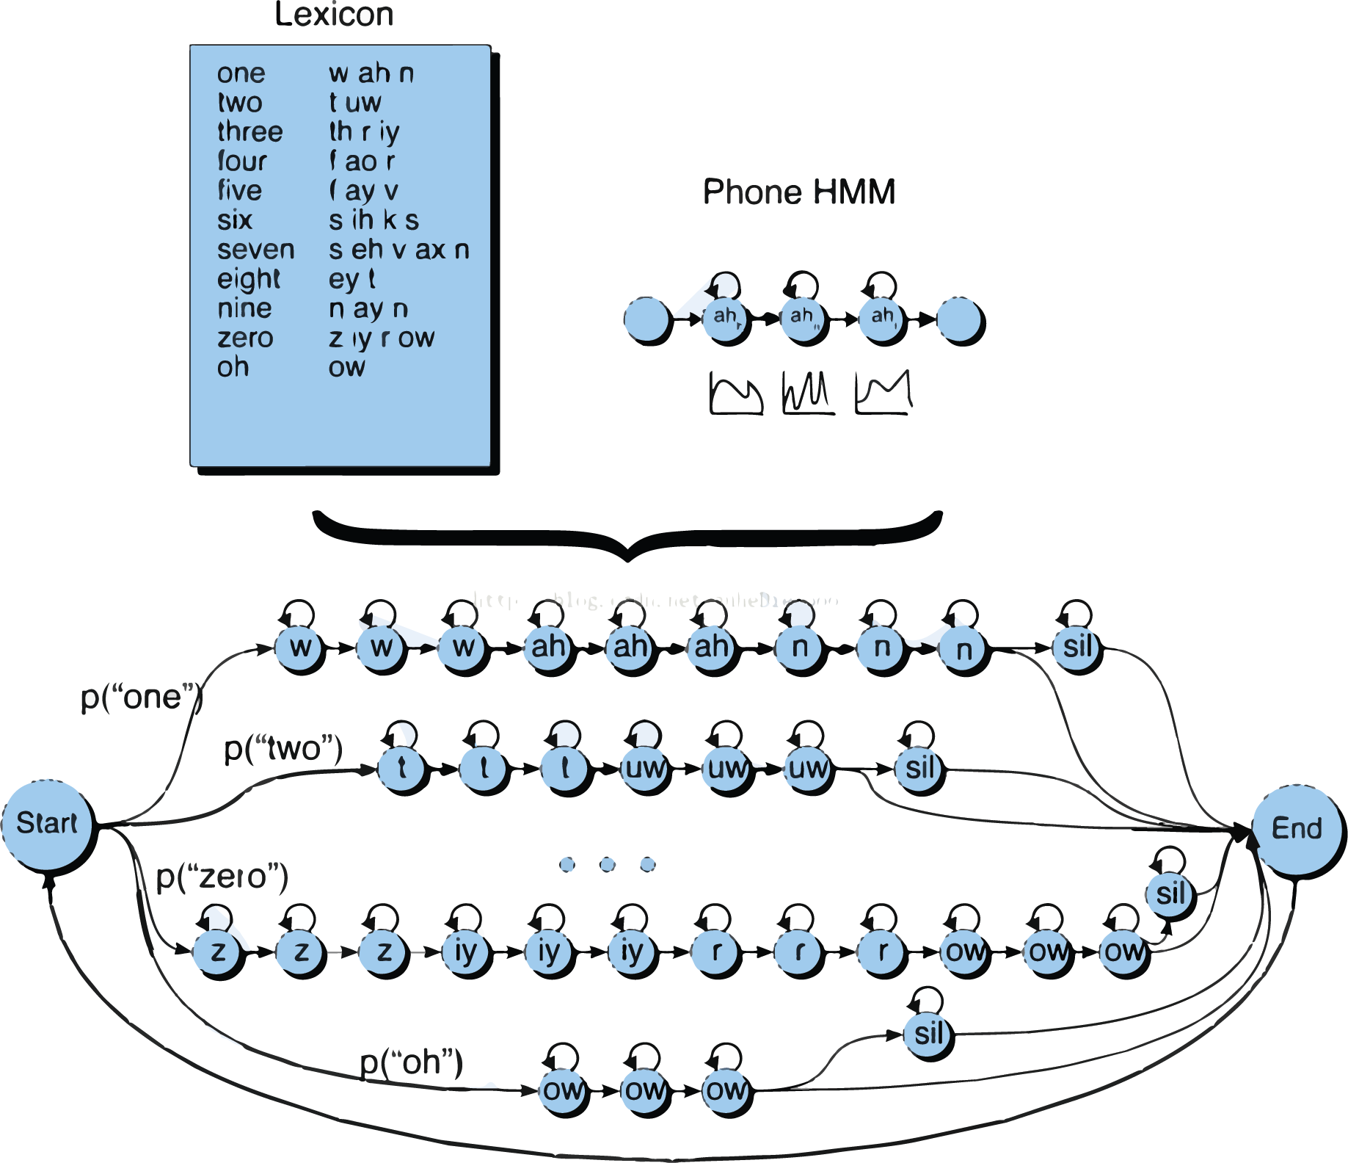
Speech Generation Process of GMM-HMM Model of Speech Recognition Technology
After entering a state, the GMM model generates all speech frames belonging to that state for the probability distribution function.
Each speech generation process corresponds to a generation probability.
Conversely, given any piece of speech, the probability that the model will generate that speech can be calculated.
Probability: How well a certain piece of speech signal matches the model.

Slide 21
N-Gram language model for speech recognition technology
Language Model:
  Describes words and the matching of words in a language.
  Helps the recognition system select words that conform to the collocation rules and reduce the influence of multiple words.
  Use N-grams to implement input text prediction
  The probability of a given N-1 preceding order followed by a word is delineated.
  When the acoustic models score similarly, the N-Gram model can select decoding results that better conform to the rules of the language.
highest probability
The language model gives these 5 words with the highest probability
Example: I / eat / XX
Sentence | 句子 | Probability
I / eat / | fruit | 0.1
 | fish | 0.2
 | sun | 0.0000003
 | very | 0.000001
 | last year | 0.000000004

Slide 22
The Decoding Process of Speech Recognition Technology
The process of speech to text needs to consider the probability of generating speech signals by the acoustic model and considering the probability of inter-word collocation given by the language model → The search space is very large.
Not to mention, with each new speech frame received, the decoder needs to consider adding a new phoneme or word → search space for expansion, with a chance to get out of hand.
Pruning Search → Retains only the candidate sentences with the highest current match after each expansion.

Slide 23
The Decoding Process of Speech Recognition Technology
Speech recognition systems typically maintain the structure of the Finite State Transducer (FST) to organize the search space.
FST maps an input sequence to an output sequence.
  Construct an FST that maps a sequence of speech frames to a sequence of words and integrate the probabilities of the acoustic model and the language model into this mapping process.
  When decoding, you only need to search for the path with the highest probability in the FST to get the decoding result → greatly improve the decoding efficiency.

Slide 24
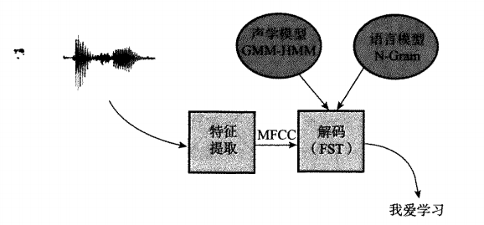
Speech Recognition Technology –
Deep Learning Speech Recognition System DNN
  In 2009, Deep Neural Networks (DNNs) were introduced in 3 phases to the field of speech recognition.
  DNNs are used to extract more efficient features, replacing traditional MFCC.
  Replacing GMM, DNNs are used to calculate the probability of each state of the HMM.
  Replacing HMM, recurrent neural networks (RNNs), a kind of DNNs, are used to describe dynamic changes in the pronunciation process.
聲學模型GMM-HMM
語言模型
N-Gram
特徵提取
解碼
(FST)
我愛AI
DNN取代

Slide 25
Speech Recognition Technology –
DNN Feature Extraction
MFCC features are greatly disturbed by noise, and in practical application scenarios, the degree of differentiation will be reduced.
DNN extracts typical features related to the target task from the raw data.
DNN features are automatically discovered by learning from raw data and are more differentiated.
DNN improves system performance.

Slide 26
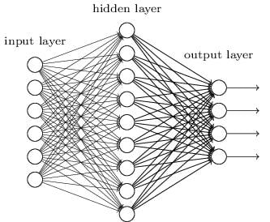
Speech Recognition Technology-
DNN Feature Extraction
Analysis: 9 different positions responsible for different analytical tasks
Input: 6 features were collected from audio speech
Output: 4 different decisions came out

Slide 27
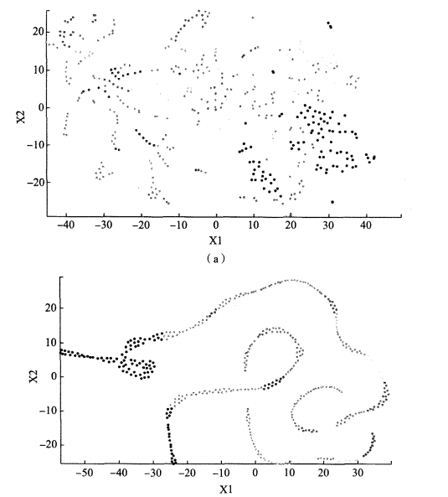
Speech recognition technology
DNN VS MFCC
MFCC
The sentence is “The sun shines brightly, but it is not as bright as a candle for one person”.
The DNN feature shows stronger regularity and better differentiation of the phonemes than the MFCC feature.
DNN

Slide 28
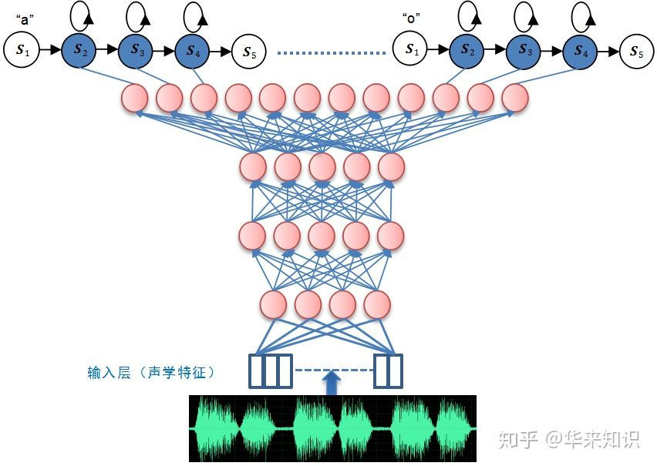
DNN Static Modeling of Speech Recognition Technology
Output Layer
(HMM)
Significant disadvantages of GMM:
  Complex pronunciation requires a large Gaussian distribution to achieve a better description, which is not efficient.
  Focus only on the description of the pronunciation itself, not on the distinction between different pronunciations.
DNN can compensate for the above shortcomings and replace GMM.
DNN-HMM model.
The DNN-HMM model combines DNN feature extraction and static modeling of DNNs into a single network → without a separate feature extraction process.
Hidden Layer
(DNN)
Input Layer (Audio)

Slide 29
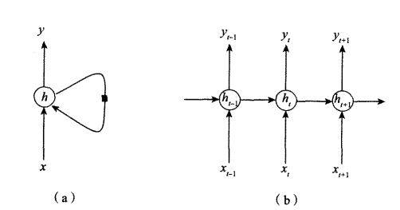
Dynamic Modeling of RNNs for Speech Recognition Technology
HMM mode simplifies the development of speech into a sequence of discrete states → does not conform to the process of continuous change of pronunciation replaced by recurrent neural networks (RNNs).
The RNN adds a feedback connection on the node that accepts information from the previous moment and therefore has a memory function.

Slide 30
An Example of Speech Recognition Technology –
Deep Playground
https://deeperplayground.org/#activation=tanh&regularization=L2&batchSize=10&dataset=circle&regDataset=reg-plane&learningRate=0.03&regularizationRate=0&noise=0&networkShape=4,2&seed=0.26799&showTestData=false&discretize=false&percTrainData=50&x=true&y=true&xTimesY=false&xSquared=false&ySquared=false&cosX=false&sinX=false&cosY=false&sinY=false&collectStats=false&problem=classification&initZero=false&hideText=false&animationSpeed=100&layerwiseGradientNormalization=0&learningRateAutotuning=-1&preventLossIncreases=false&dropout=0&momentum=0

Slide 31
Example of Speech Recognition Technology - SPEECHTEXTER
https://www.speechtexter.com/
SpeechTexter uses Google Speech recognition to convert the speech into text in real-time. This technology is supported by Chrome browser (for desktop) and some browsers on Android OS.

Slide 32
The Basic Method of Speech Synthesis
Speech synthesis is the process of generating a sound from text. It lets the machine make a sound according to the instructions of the person.
Speech synthesis methods are divided into 4 types:
(1) parametric synthesis,
(2) splicing synthesis,
(3) statistical model synthesis, and
(4) neural model synthesis.

Slide 33
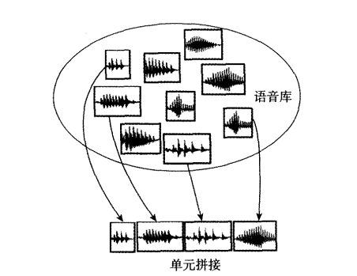
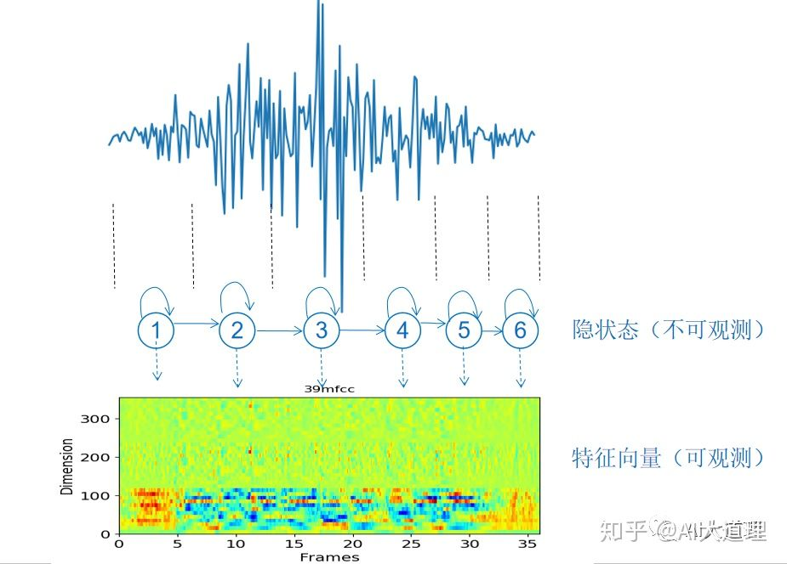
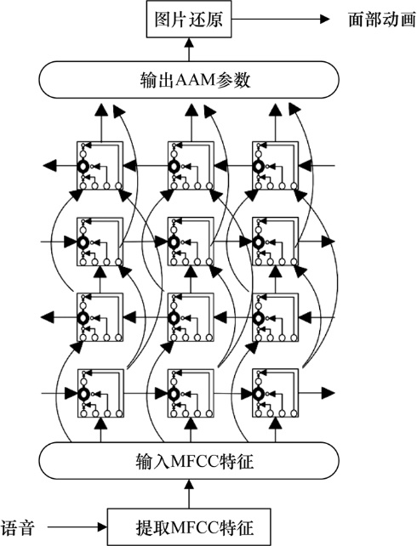
The Basic Method of Speech Synthesis
Parameter Synthesis - Produces different sounds by adjusting the formant parameters of the channel.
Stitching Synthesis - When the pre-recorded speech is cut into pronunciation fragments (usually phonemes) for synthesis, the appropriate candidates are selected from these fragments to be stitched together to form sentences.
Statistical Model Synthesis - A statistical model is built for each pronunciation unit, which is generated using only these models at the time of synthesis.
Neural Model Synthesis - RNN-based synthesis system. The RNN model learns the before-and-after correlations during pronunciation, resulting in smoother, more natural pronunciation.

Slide 34
The Basic Method of Speech Synthesis
Text to Speech Online
Type, paste, and edit text here. Natural Reader Online is a text to speech web application that converts any written text into spoken words.
https://www.naturalreaders.com/online/

Slide 35
Experiments with Speech Synthesis Help
The sounds heard in daily life are a mixture of multiple sources: vocals, noise, musical sounds, etc.
3 ways to separate sounds:
  Multi-Channel Approach uses multiple microphones to record simultaneously, using spatiotemporal information from different sources and between microphones to locate and separate the sound of a certain source.
  Single-Channel Approach records with a single microphone and separates each source using its unique pattern or signal continuity
  Deep Clustering Approach separates promiscuous speech.

Slide 36
Deep Clustering
Converts sound into spectrograms
Using a deep neural network, each time-frequency (TF) block on the graph is mapped to a feature space.
Makes the adjacent matrix of each TF block in the feature space as similar as possible to the adjacent matrix of the actual label.
Clusters TF blocks of mixed speech
Chooses a TF block of the same class as the spectrum of a sound source.

Slide 37
Deep Clustering
Ex1：
https://www.youtube.com/watch?v=NzZDnRni-8A&t=34s
Ex2：
https://www.youtube.com/watch?v=Z_ogAiVoE1g

Slide 38
Understanding the Complexity of Human Language
The complexity of human language
Structure
Semanteme
Knowledge
Apply
Spacetime

Slide 39
Understanding the Complexity of Human Language - Structural Complexity
Structure
Start by forming in your mind the intention that needs to be expressed
Choose a reasonable expression based on these intentions
Choose the words that are appropriate to express the core idea
Organize sentences according to grammar
  - Rich hierarchy (words, phrases, sentences, paragraphs)
  - Complex dependencies (correlation between words, semantic association between small sentences, logical continuity between sentences)

Slide 40
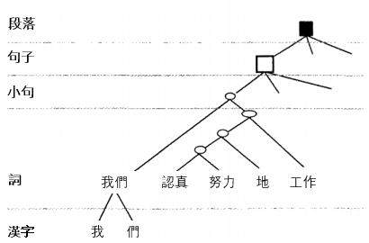
Understanding the Complexity of Human Language - Structural Complexity
Structure
Use “If we work hard, we will make a greater contribution and make our country stronger. Otherwise, other countries will look down on us.” as an example.
There are three clauses inside, two reasoning relationships
Work hard → make a greater contribution → our country is stronger
Take the sub-sentence "We work hard " as an example:

Slide 41
Understanding the Complexity of Human Language - Semantic Complexity
Semantics
Ambiguity stems from the word itself or structurally when words and words are combined with each other. For example:
“Flying planes can be dangerous.”
There are two different interpretations of the sentence based on different syntactic structures:
(1) Planes which are flying can be dangerous.
(2) The action of flying planes can be dangerous.

Slide 42
Understanding the Complexity of Human Language - Knowledge Complexity
Knowledge
Human language not only contains grammatical structure and semantic content, but also has a wealth of knowledge. For example: “Coal contains carbon and produces carbon monoxide when not burned sufficiently. Carbon monoxide enters the human body and binds to red blood cells, causing red blood cells to lose their oxygen-carrying function and produce carbon monoxide poisoning. Therefore, we should try to maintain ventilation when burning coal, especially in low-pressure weather, and pay special attention.”
The above sentence involves specialized knowledge, such as:
- Knowledge of the chemistry of carbon monoxide
- Knowledge of the physiology of oxygen-carrying hemoglobin

Slide 43
Understanding the Complexity of Human Language - Spatiotemporal Complexity
Spacetime
Differences in the languages spoken by people in different regions:
  - There are nearly 7,000 languages spoken worldwide
Differences in the languages used by people of different eras:
  - The same language also differs greatly in terms of word creation at different historical periods:
  - Classical vs Vernacular
  - Internet buzzwords

Slide 44
Understanding the Complexity of Human Language - Application Complexity
Application
Spoken and written language
Prone to spelling errors and syntactic errors
The headline of the news is wrong: “Every Kirklees business given a zero or one star food hygiene rating”.

Slide 45
Text-based natural language understanding
What is language understanding?
To what extent does the machine "understand" language?
Analytical thinking: Clearly analyze the various components of a sentence and their relationships
Feedback idea: No matter how the machine parses the sentence, as long as it can give enough reasonable feedback, it has language comprehension ability; the Turing test believes that the machine has a 30% chance of deceiving the tester can understand human language and has human intelligence.
Traditional Language Understanding Methods & Language Understanding Based on Deep Learning:

Slide 46
What is language understanding?
Traditional methods of language understanding
Lexical analysis
Syntactic analysis
Semantic analysis
Word: Can be one word or multiple words such as Run, Sun
Parts of speech:
  Run = Verb that represents an action
  Sun = noun, representing an object
Most words have several meanings:
  “bank" can mean river bank or financial bank
Chinese lexical analysis unique participles
Chinese there is no clear word boundary → The first task of lexical analysis is to cut successive sequences of Chinese characters into independent words
The most common word segmentation is the longest match method: the sentence is sliced by the longest word in the thesaurus as much as possible
Earlier part-of-speech annotation algorithms relied on rules, such as nouns followed by verbs, and adjectives appeared before nouns
Parsing of sentence content
Transform sentences expressed in natural language into a kind of knowledge
Semantic Role Annotation (Shallow Semantic Analysis)
  Find the central predicate of a sentence and identify the relevant components of that predicate, such as doing, receiving, time, and place
More complete semantic analysis:
  Semantic expression formatting
  The meaning expressed is a clear, unambiguous, flexible expression that can express more complex semantics
Semantic dependency tree

Slide 47
A Language Understanding Approach Based on Deep Learning
Does not rely on the parsing of sentence components → map sentences to a semantic space.
In the semantic space, sentences with similar semantics are less distant, and sentences with large semantic differences are farther away.
Can aid complete questions and answers, translation and other work.
Based on the feedback idea of language understanding, as long as the machine successfully completes the target task, it is considered to have the ability to understand.

Slide 48
Comparing Traditional and Deep Learning Methods
Traditional method | Deep learning method
Advantages
Through an in-depth analysis of sentence components, the semantic content in the sentence can be fully understood. Parsing results based on syntax and semantic rules are not too biased, and even if there is a parsing error, it is easy to locate the cause. | There is no need to artificially design the knowledge structure, just a large amount of text as training data, you can learn a reasonable semantic space. The semantic space can be trained with a large number of texts outside the domain, and the resulting semantic space can still be used for language understanding tasks within the field (such as non-professionals who do not understand medical terms, but from daily language experience, they can learn the communication skills of basic medical dialogue).

Slide 49
Comparing Traditional and Deep Learning Methods
Traditional method | Deep learning method
Disadvantages
Be very knowledgeable in the field. Relying heavily on lexical analysis and syntactic analysis, errors in these links are easily transmitted and accumulated during semantic analysis, resulting in biased results. Natural language contains many expressions that do not conform to lexical and syntactic analysis, especially new expressions from time to time → putting a lot of pressure on lexical and syntactic design. | Unexplainable semantics: Deep learning is black-box learning without careful parsing of sentences. It is difficult to clearly understand the semantic origin of a sentence → The resulting semantics are not sufficiently representative of the individual.
Areas of expertise
Performs better on specific tasks (domain-specific Q&A and dialogue). | Better performance in generic tasks (chat and translation).

Slide 50
Machine translation technology
Early machine
translation
Late 1970s
Late 1980s
1993
2003
2014
2018
The era of the US-Soviet arms race: the United States invested heavily in the development of Russian-English translation, while the Soviet Union developed British-Russian translation
It basically ended in failure
The TAUM-METEO system, jointly developed by the University of Montreal in Canada and the Translation Agency of the Federal Government of Canada, can be used to translate weather forecasts
Rules-based translation, including direct translation, translational translation and intermediary language translation
All methods require a lot of linguistic knowledge and are lowly practical
Modern statistical machine translation (SMT) methods: no artificial linguistic knowledge is required, only an enough bilingual corpus is required for the machine to learn the correspondence between the two languages → greatly reducing the resources required for machine translation
Koehn of the University of Edinburgh proposed a phrase translation model that further improved the effectiveness of machine translation
Neural Network Translation (NMT) model was introduced and proposed by Google
Microsoft announced that its NMT system surpassed humans in Chinese-English translation

Slide 51
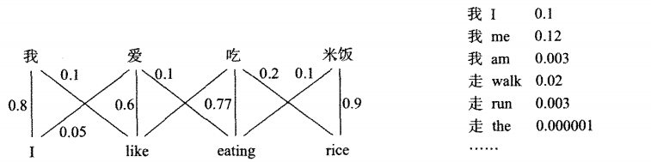
Statistical Machine Translation
Automatically learns the language fragments corresponding to the two languages from the corresponding bilingual corpus and completes the automatic translation.
A probability is attached to each corresponding fragment, indicating the probability of the correspondence → forming a mapping table between the original language and the target language.
我
愛
吃
白飯

Slide 52
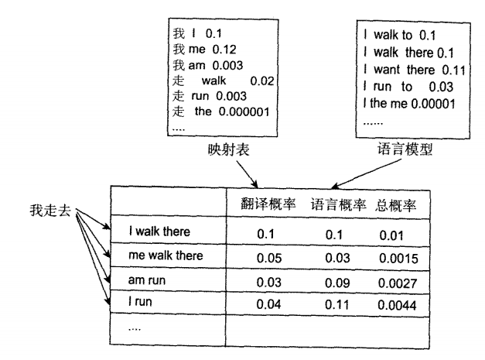
Statistical machine translation
The translation probability of the mapping table is multiplied by the linguistic probability based on the language model, and the largest translation candidate is the best translation of the original sentence.
Flaws in statistical machine translation: The search is based only on inter-word probabilities and does not understand the sentences → word combinations are stiff.

Slide 53
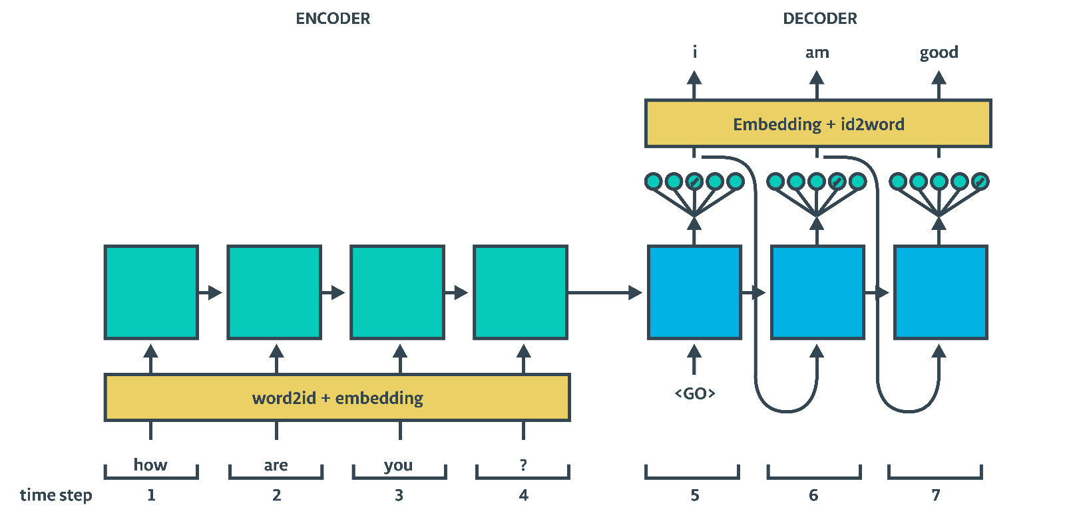
Neural machine translation
Sequence-to-sequence neural machine translation model (NMT)
The sentence to be translated is compressed into a sentence vector (encoding) by a recurrent neural network (RNN)
Based on this sentence vector, another RNN iteratively generates the target translation (decoding)
Decoding semantics rather than the words themselves → Implementing cross-language semantic reproduction (translation)

Slide 54
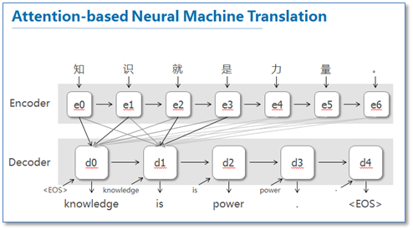
Attention Mechanism
Solves the problem that when the sentence is long, the sentence vector S of a fixed dimension may not form a complete expression of the semantics of the entire sentence.
Method: In the NMT translation process, it no longer relies on a fixed sentence vector, but looks for the current position in the original sentence that should be paid special attention to, and translates based on the semantics of that position.

Slide 55
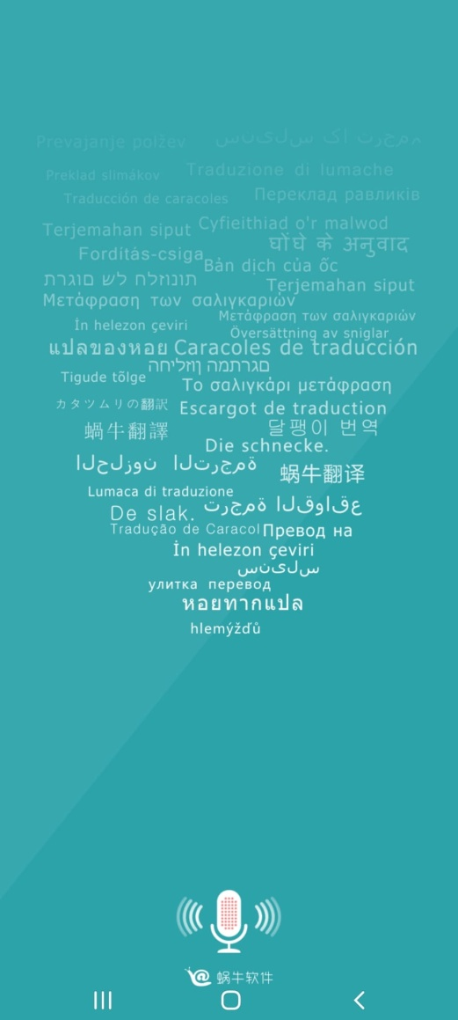
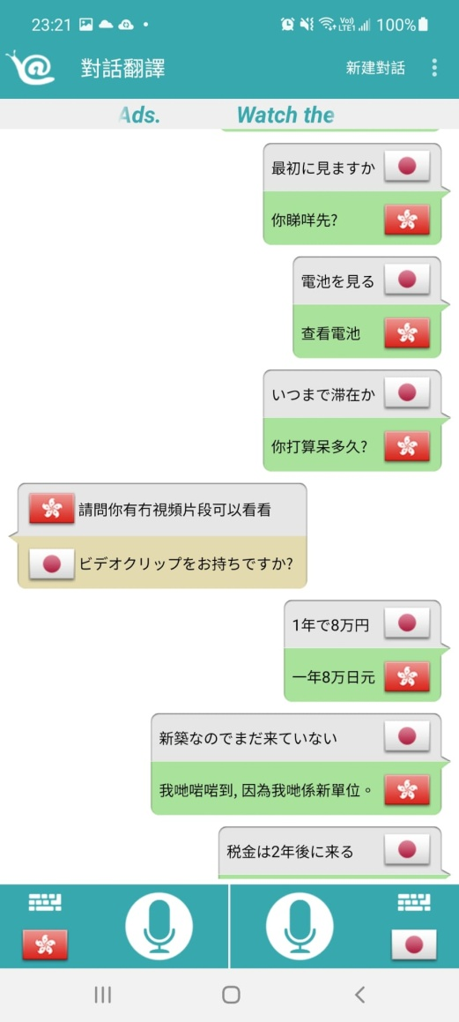
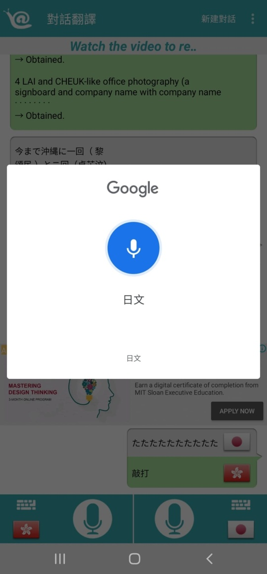
Example: Translate Voice (Translator)
Step 1
Step 2
Step 3

Slide 56
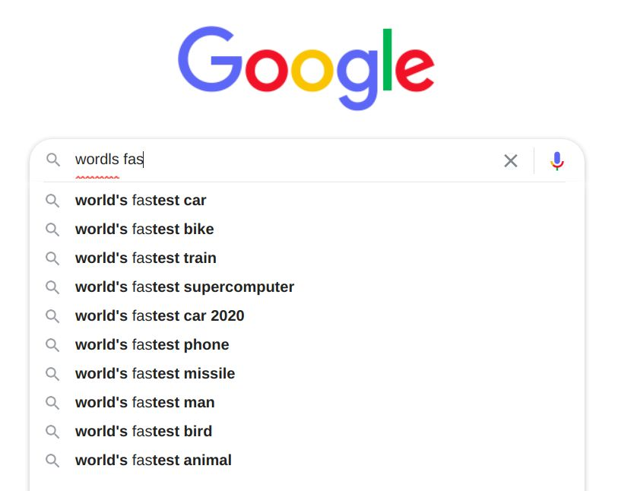
Other Applications of Language Understanding - Search Engines
The early search engines were basically a list of high-quality websites, and later developed into automatic indexing technology.
Vector Space Approach represents each web page as a document vector.
Vectors describe how often important words appear in a web page and adjust the vector based on how important each word is (E.g., divide by how often the word appears in all documents).
The user's input is also represented as a document vector, which is compared to the document vector of each web page in the database → finding and entering the most relevant document.

Slide 57

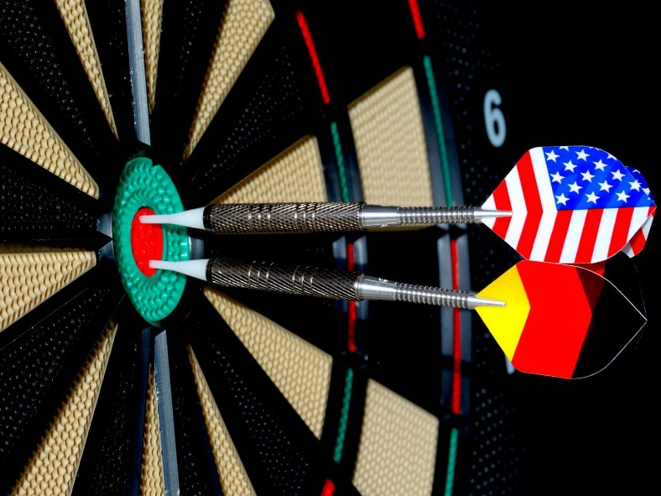
Other Applications of Language Understanding – Recommender Systems
When we search for one piece of content, the system automatically recommends other relevant content for us.
After the user logs on to the social networking site, the system will calculate the content that the user is interested in in a short period of time, and quickly form the user‘s personalized information (user portrait) → Recommend appropriate content for the user based on the portrait.
In the process of user browsing, the system collects the user’s browsing habits to correct the user portrait → more refined recommendations.
Even if the number of views by a user is small, the system can optimize the user‘s profile based on the browsing behavior of similar users.
Use information such as historical reading, social network content, login habits, etc., to form a vector expression (user portrait) of users → Calculate the correlation between users and users, users and browsing content, and accurately recommend through a full range of related information.
Survey analysis
Targeted advertising

Slide 58
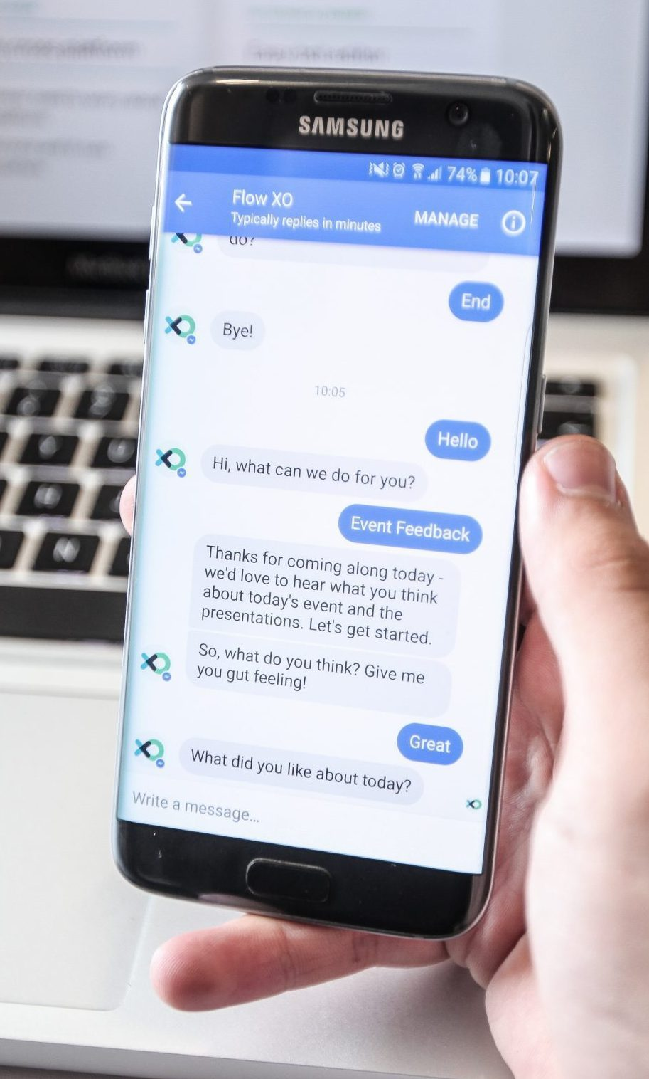
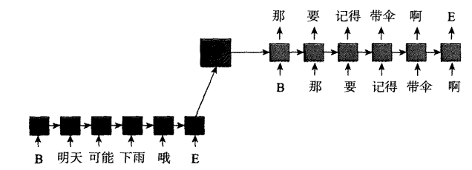
Other Applications of Language Understanding - Conversational bots
Siri from Apple.
At present, the mainstream conversational robots are mostly based on deep learning models.
Sequence-to-sequence translational models: In their structure, the environment and reply replace the source language input and the target language output, respectively.

Slide 59
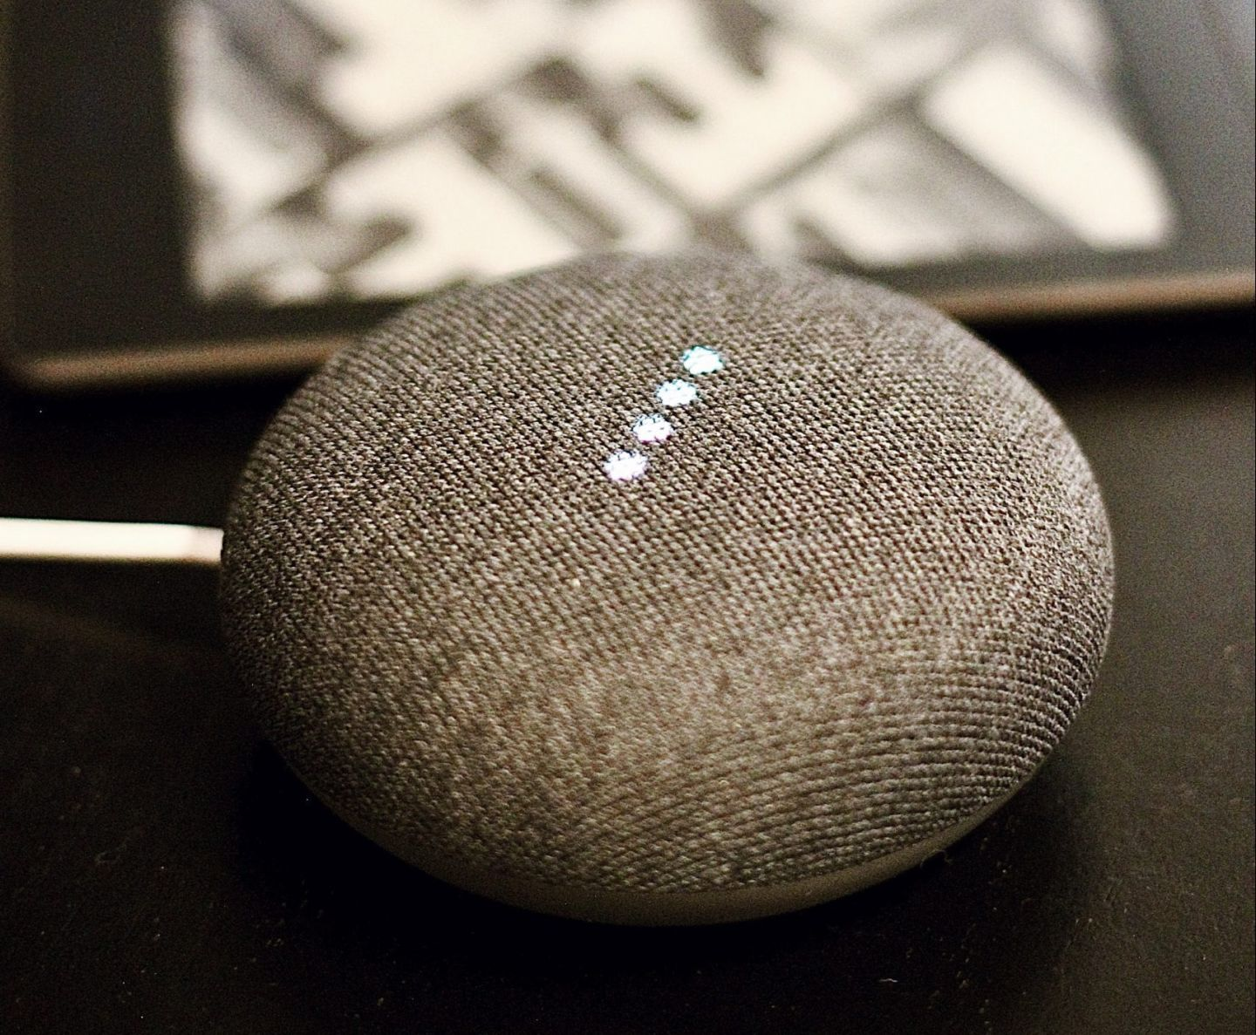
Other Applications of Language Understanding - Voice assistants
A voice assistant is a software that uses speech recognition, natural language understanding, and natural language processing to understand a user's verbal commands and perform actions accordingly.
Although it is similar to a chatbot, it can do more than a chatbot.
For example, Amazon's online shopping platform.

Slide 60
What Natural Language Processing Problems Have Not Been Solved By Deep Learning?
Resource scarcity
Interpretability and trustworthiness
Controllability
Lengthy texts
Lack of general knowledge
https://www.leiphone.com/category/academic/3fbKEVpvrivuV1jb.html

