Slide 1
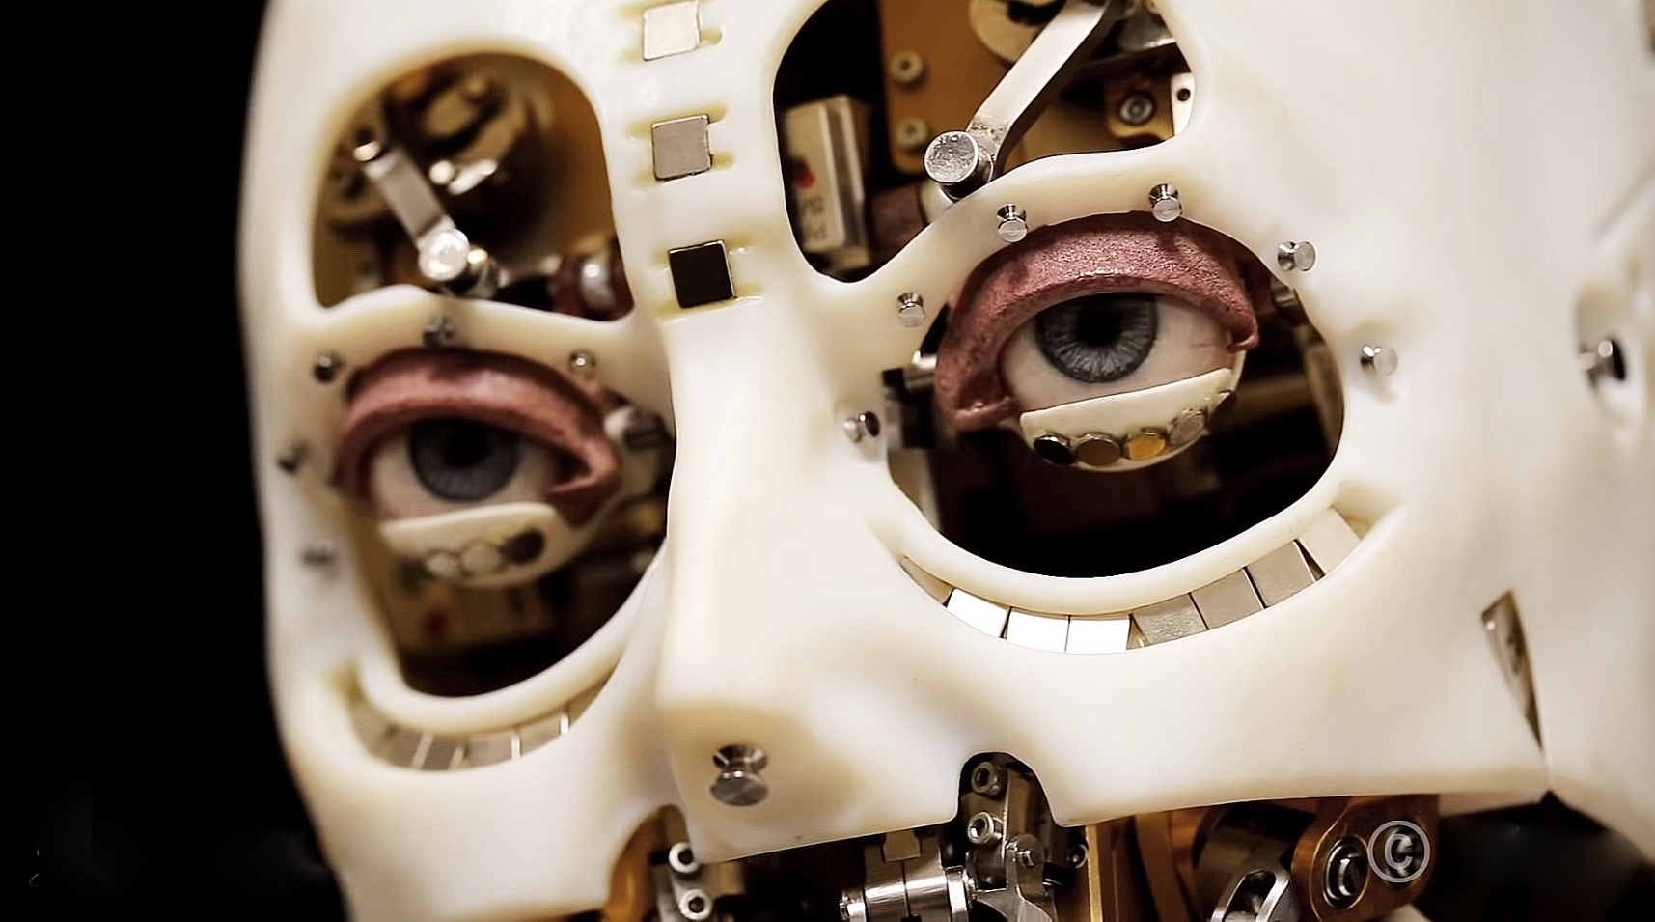
Session 4:
Imitate your behaviour

Slide 2
Contents
The history of modern robot development
Robots based on design
Robots based on learning
Deep reinforcement learning
Introduction to Design Thinking

Slide 3
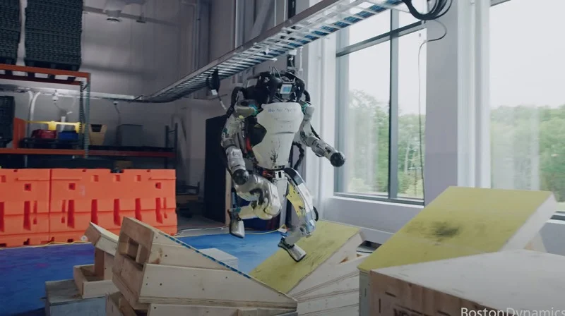
The History of Modern Robot Development
Boston Dynamics' Atlas robot
https://youtu.be/tF4DML7FIWk

Slide 4
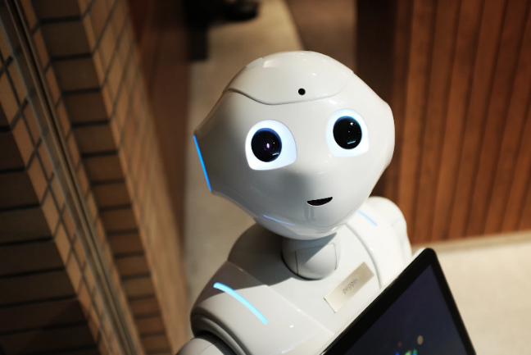
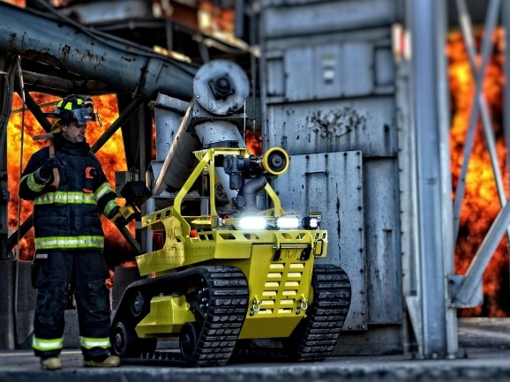
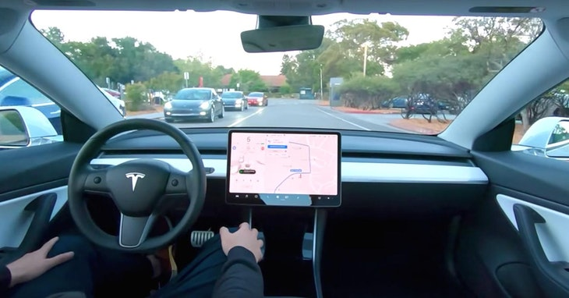
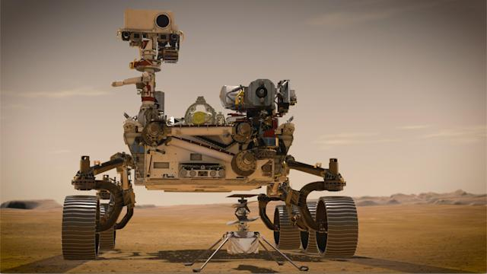
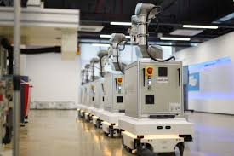
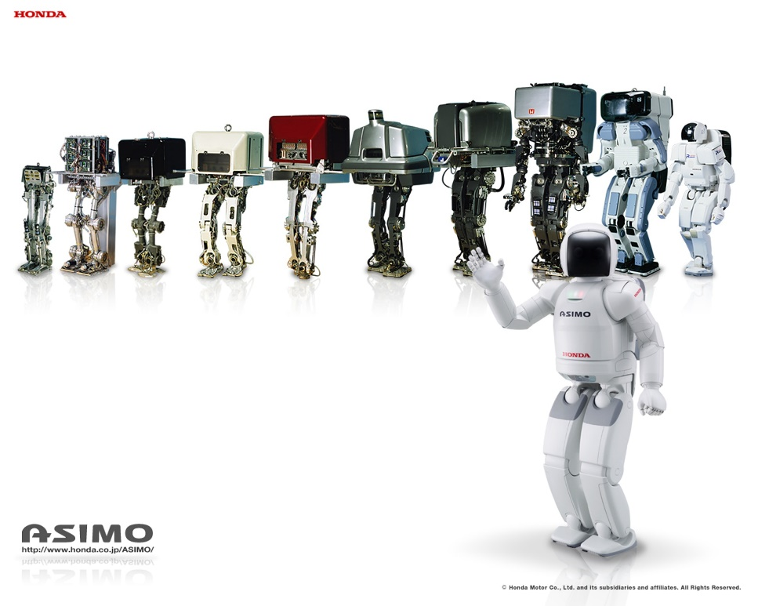
What are the Main Problems that Human-designed Robots Need to Solve?
https://stylenculture.hk01.com/%E7%94%9F%E6%B4%BB%E6%99%82%E5%B0%9A/206262/%E5%86%8D%E8%A6%8Basimo-%E6%9C%AC%E7%94%B0%E7%B5%82%E6%AD%A2%E6%A9%9F%E6%A2%B0%E4%BA%BA%E7%A0%94%E7%99%BC%E8%A8%88%E5%8A%83-%E6%97%A5%E5%BE%8C%E5%8F%AF%E5%9C%A8%E5%93%AA%E8%A3%8F%E5%86%8D%E9%81%87asimo

Slide 5
The History of Modern Robot Development
After nearly a hundred years of development, robots have gone through three stages of imitation, perception and intelligence, and have now become an important partner of mankind, playing an important role in industrial production, nature exploration, rescue, education and entertainment.

Slide 6
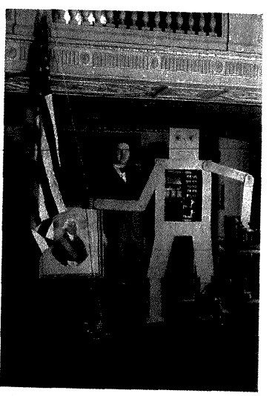
The History of Modern Robot Development
In 1927, Roy J. Wensley, an engineer at Westinghouse Electric, built the first robotic "telegraph box" (pictured).
The telegraph box has a wireless telegraph function and can answer some simple questions.

Slide 7
The History of Modern Robot Development
In 1947, the Argonne Institute of the American Atomic Energy Commission developed a remote-control manipulator.
In 1948, a mechanical master-slave manipulator was developed, which controlled the main manipulator to control the target action from the manipulator.
In 1954, American engineer George C. Devol filed a patent application with the U.S. government for a "repetitive operation robot" for industrial production.
→ This was the original idea of an industrial robot.
Early robotics were designed to replace humans with radioactive material.

Slide 8
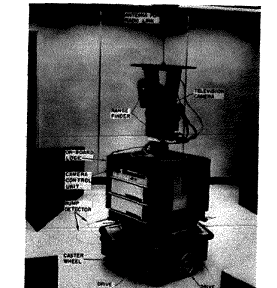
The History of Modern Robot Development
1960s
Various robots loaded with sensors have come out one after another, allowing robots to have perception.
1961
H. A. Ernst adopted tactile sensors to help control the robotic arm; Tomovic and Boni designed a "smart hand" called Belgrade in 1962, using a pressure sensor to detect the force of the "hand”.
1965
Lawrence Robert of the Massachusetts Institute of Technology (MIT) in the United States introduced the world's first robot with a vision sensor that can identify and locate blocks.
1969
SRI Labs designed the Shakey Robot, which can use vision sensors to grasp blocks and have the ability to walk.
1979
Unimation introduces the PUMA series of industrial robots, a programmable, universal industrial robotic arm with configurable vision, haptic, and force sensors. The introduction of PUMA marks the maturity of industrial robotics technology.

Slide 9
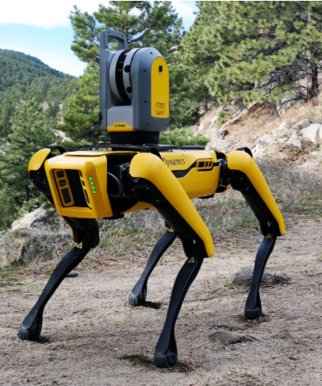
The History of Modern Robot Development
In recent years, artificial intelligence technology has brought another leap forward in the development of robots.
Robots integrate more perception and learning capabilities, and can balance walking in complex scenes, and stand up after falling (Boston Dynamics's robot Big Dog): they can effectively perceive the environment through vision, hearing and make behavioral decisions; they can identify people's identities and emotions; and can quickly adapt to new working environments.

Slide 10
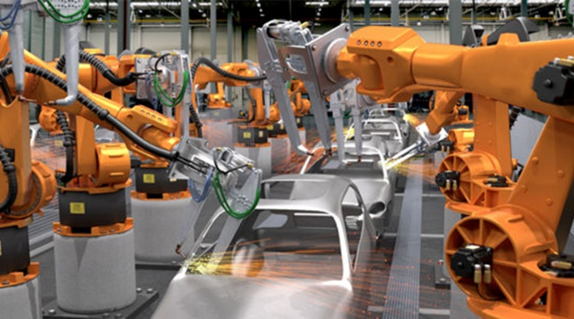
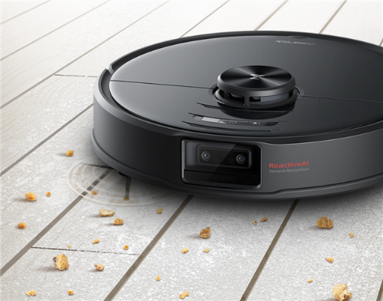
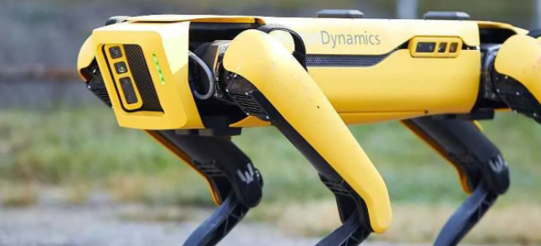
The History of Modern Robot Development
It should be noted that the robot is a general term for intelligent machines, and may not have the form of a person.
In fact, the robots that are widely used today are non-humanoid.
Industrial robots are mostly just a robotic arm.
Most of the sweeping robots are discs that move close to the ground.
Many robots are actually animal forms, such as robotic dogs, mechanical butterflies, and mechanical snakes.

Slide 11
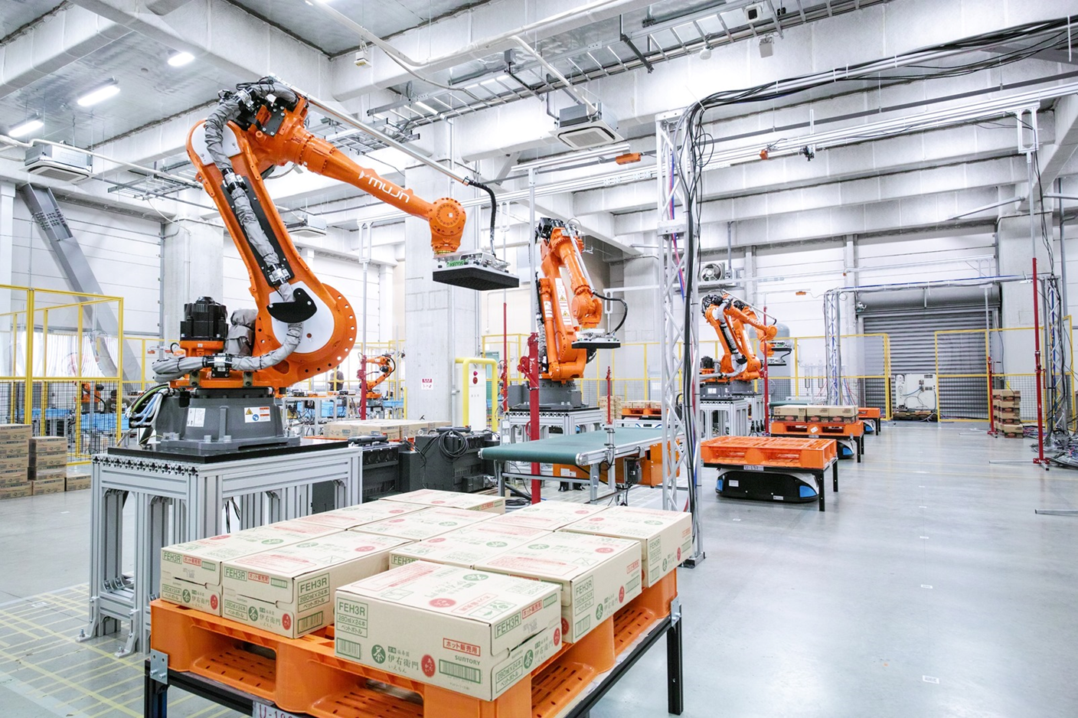
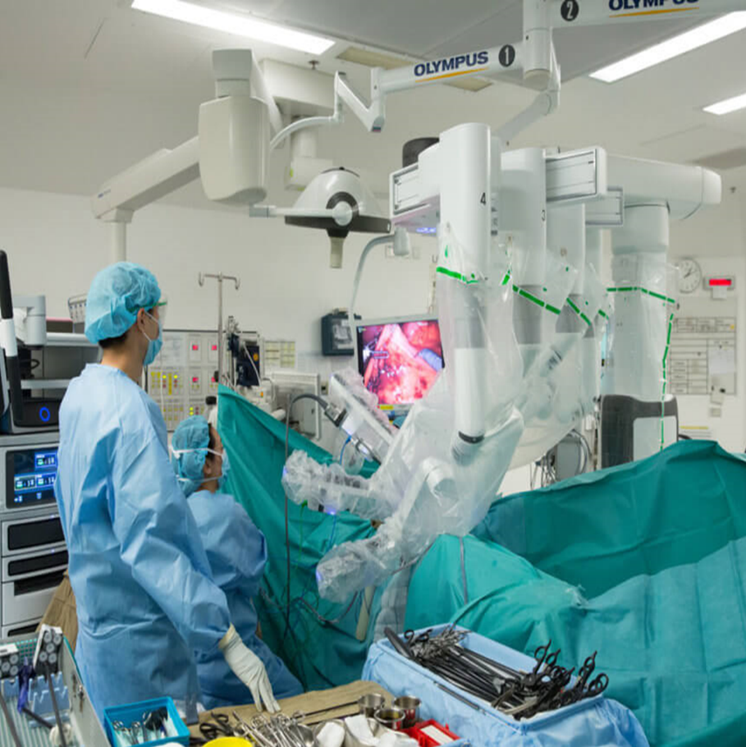
The History of Modern Robot Development
At present, the most widely used field of robots is industrial manufacturing → especially in the automobile manufacturing industry, in which many jobs are done by robots automatically.
Another is the medical field, such as surgical robots can help doctors complete very delicate surgeries, and capsule robots can assist doctors in finding symptoms.
In the field of high-risk operations, robots also play a big role, such as fire-fighting robots and underwater robots.

Slide 12
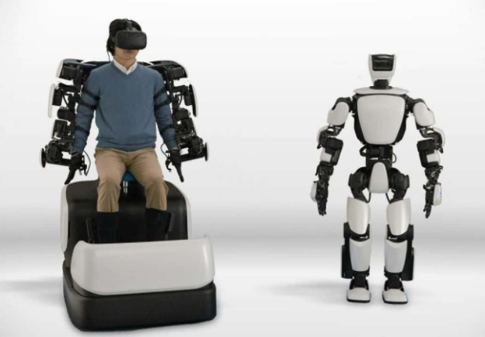
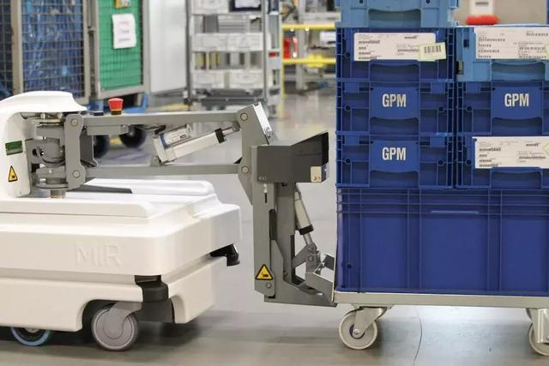

Robots Based on Design
Robots can be divided into two categories according to behavior: operating robots and mobile robots:
  Operating robots focus how to accomplish a certain action through joint movements. E.g., Robotic arms for automotive processing.
  Mobile robots focus on how to plan a route to reach their destination. E.g., Driverless cars.
In fact, many robots need to do both operation and movement at the same time.
Boston Dynamics Big Dog Robot: Opening the door, stepping, raising legs, planning routes to get around obstacles and prevent collisions.

Slide 13
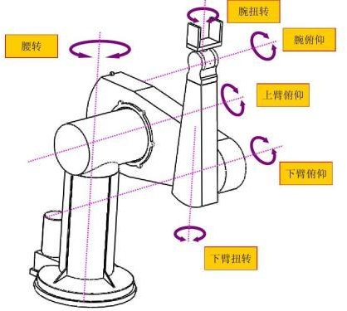
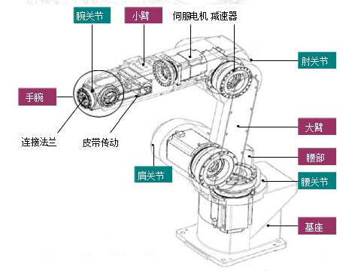
Operating Robots Based on Design
Operating a robot requires the completion of certain specified actions, such as grasping, welding, etc.
The key to achieving the action: how to place the end of the robotic arm in a preset position.
The end refers to the working point of the robotic arm, generally the end of the robotic arm.
This problem seems simple, but it is quite complex to solve, involving a lot of knowledge such as kinematics, dynamics, and cybernetics.

Slide 14
Mobile Robots Based on Design
A robot moving on the ground
Mission:
  Enable effective mobility
  Build a map of your environment and estimate your own position in the map
Mission 1: Different kinds of robots achieve effective movement in different ways
  Autonomous vehicles: Effective movement can be achieved by refueling, but the restrictions when moving should be considered (such as not being able to move in parallel, considering the space occupied by the tail when moving, etc.)
  Humanoid robot: Design a reasonable limb movement (such as a leg lifting trajectory) and achieve this action through the power system.
  Effective movement can be achieved by supplying reasonable power.

Slide 15
Mobile Robots Based on Design
Mission 2: Build a map of the environment and estimate the robot's own position on the map
  A common way: carry the robot through the established route first, and let it record the scene it sees.
  Recording of the scene = observation variables: photos taken by the camera, feedback signals from the radar, etc.
  After several observations, the robot can build an internal map, which is in fact a record of the observed variables corresponding to the location.
  When the robot moves autonomously → Estimates the position it will arrive at the next moment based on its own dynamic model, and corrects the location based on the observed variables recorded on the map.

Slide 16
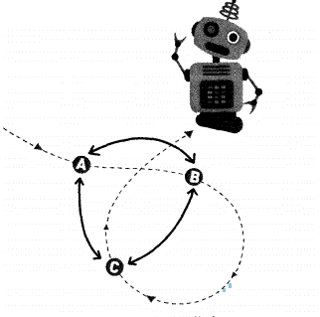
Mobile Robots Based on Design
Simultaneous localization and mapping (SLAM)
The robot is able to learn maps in real time (for location estimation and map construction) → Simultaneous localization and mapping (SLAM) algorithms
  First estimate the location of the robot based on the current map.
  This location estimate and the resulting observation variable can in turn be used to refine the map, especially when passing through similar locations multiple times.
  The location estimate is repeatedly corrected by multiple observed variables, thereby gradually improving the accuracy of the map.
In the figure on the right, the observation variables A, B, and C can be used together to correct the position estimates of these three points.

Slide 17
Robots Based on Design
The origin of map construction
LiDAR or lidar, is an optical remote sensing technique that measures parameters such as the distance to a target by shining a beam of light, usually a pulsed laser, on a target.
Lidar has applications in geomatics, archaeology, geography, geomorphology, earthquakes, forestry, remote sensing, and atmospheric physics .

Slide 18
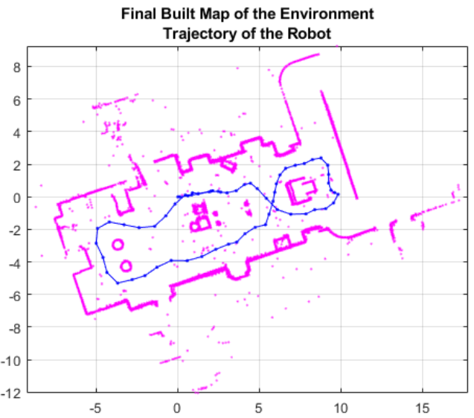
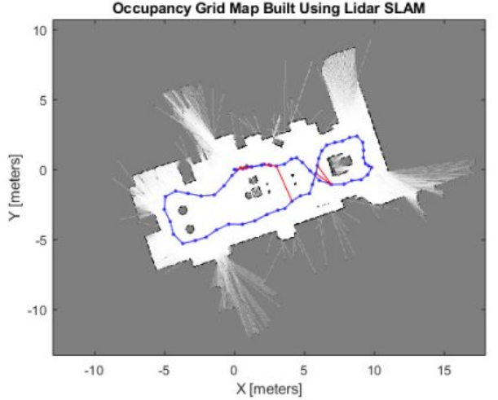
Robots Based on Design
Map constructed by SLAM algorithm
Each point (the mesh part of the plot) = position point
Connection between points = relationship between two points (e.g. path length, difference between images captured by the camera, etc.)
These points and lines form a location map.
Once you have an initial map, you can correct the map based on data from multiple observations → to get the refined map
https://www.youtube.com/watch?v=saVZtgPyyJQ

Slide 19
Learning-based Robots
Much of this robotic behavior stems from outside experience.
The experience imparted by human / the robot tries it out on his own.
There is no need to design every action of the robot; just tell it what goal to complete, and the rest is for the robot to learn on its own → reinforcement learning.

Slide 20
Learning-based Robots - Imitation Learning
Teaching the robot: human leads the robot to perform the task again, and the robot remembers the angle, angular velocity, etc. of each connection point in the process. Instead of learning on its own, the magnitude of the moment is calculated
Imitation learning robot: by constantly trying to apply torques on each connection, you can obtain a motion trajectory consistent with the teaching process, and finally obtain the operation skills to complete the teaching process.
The torque size is obtained through learning.
https://www.youtube.com/watch?v=GPOe-dZhUU4

Slide 21
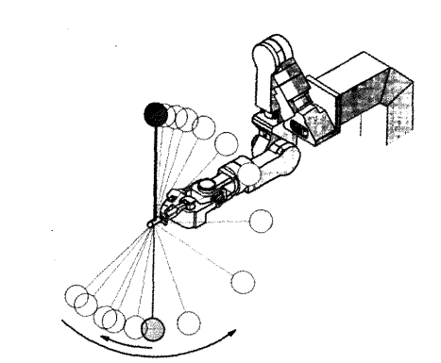
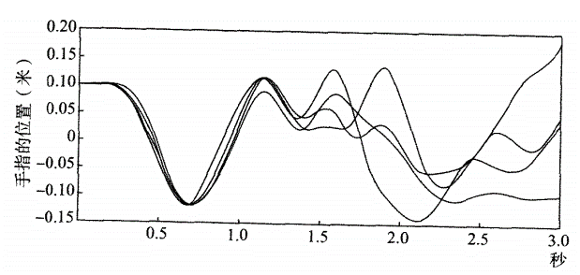
Learning-based Robots - Imitation Learning
Learn behavioral strategies: E.g., how to wrap the ball around
By connecting the ball to the end of the machine by means of a soft wire, the person will make several demos, and the machine needs to learn to wrap the ball around by learning from these demos (Fig. 1).
It is difficult to imitate the movements of human fingers (Fig. 2) → The machine imitates the shape of the trajectory of the ball after it is successfully wrapped. Try it out until you learn the art of winding up the ball.
Fig. 1: Experiment of a machine learner circling a small ball.
Figure 2: The trajectory of the fingers in several demonstrations of a person circling a small ball.

Slide 22
Learning-based Robotics –
Deep Reinforcement Learning
There are no examples for robots to imitate, and robots need to actively contact the environment, get feedback from it, and constantly revise their behavior based on this until they get the optimal solution.
We use the case of Learning to Walk to show the characteristics of reinforcement learning:
Learning to Walk | Reinforcement Learning
When learning to walk, the child will not have any purposeful movements, only random movements of limbs, parents will not deliberately help him raise his legs, step, and will not explain the benefits of walking. When the child occasionally stands and moves against the wall, the parents will give a clapping or hug, so that the child is inclined to continue to try these movements; when the child falls, he will feel pain. | During the learning process, there is no specific guidance for each action, nor is there a clear definition of the goal. But when the child's movements move closer or farther away from the target, there is a corresponding reward or punishment.

Slide 23
Learning-based Robotics vs Deep Reinforcement Learning
Learning to Walk | Reinforcement Learning
Parental applause and hugs, and the pain of falling appear after success and failure respectively. | Rewards or punishments do not appear immediately, but only after completing a series of actions.
Cannot learn to walk in a day. You need to keep trying. | The learning process must be constantly trying in order to gain experience.
If you are unstable, you will fall, and a certain action may have a series of effects on subsequent actions. | A certain joint movement directly affects subsequent movements.
Children will gradually learn the skills of standing and walking, and eventually learn to walk little by little. | Usually not focusing on the success or failure of a particular action, but the overall effect of all actions (eventually learning to walk).

Slide 24
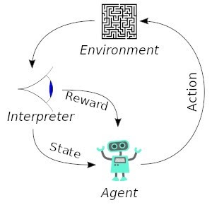
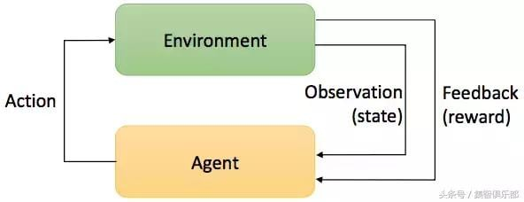
Flowchart of reinforcement learning
Interact with the environment actively
Maximize the final benefits
Learn behavioral strategies using feedback (rewards or punishments) given by the environment.

Slide 25
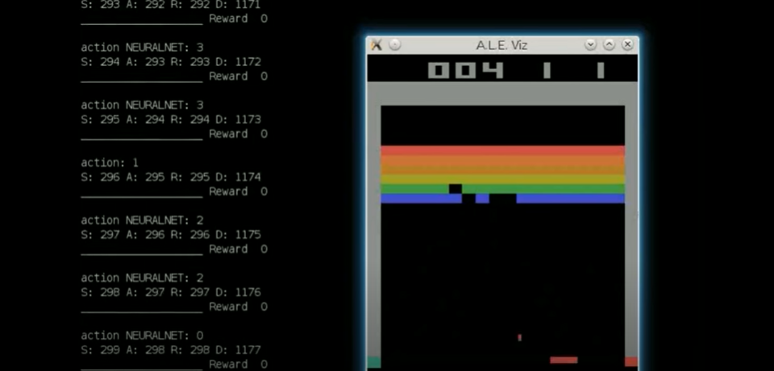
Deep Reinforcement Learning: Atari
DeepMind uses the Deep Q-Learning Network (DQN) to teach machines to play Atari games.
Learning Method:
  Pass the game footage to the computer and let it control the joystick by observing the footage, operating the game like a human.
  Typical reinforcement learning tasks: the observation value is the game screen seen; the movement is the manipulation of the play pole; the feedback is the reward score given on the screen, and the total gain is the total score obtained after the game is over.
  https://www.youtube.com/watch?v=V1eYniJ0Rnk

Slide 26
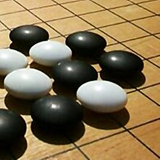
Deep Reinforcement Learning: AlphaGo Zero
Go program developed by DeepMind.
Using the deep reinforcement learning method, the entire chessboard is used as input, the chess game state is extracted by several layers of convolutional neural network (CNN), and the training is based on the reinforcement learning method. A large number of supervised learning has also been added to mimic the human way of moving chess.
AlphaGo Zero completed 4.9 million self-games in three days. Within days it had developed the skills to beat the top human players, and the early AlphaGo took months of training to reach the same level.
https://www.youtube.com/watch?v=tXlM99xPQC8

Slide 27
Deep Reinforcement Learning: Physical Robots
In 2008, Oita University in Japan asked a mechanical dog named AIBO to kiss a white mechanical dog.
Adopts a similar structure to the Atari Game Network:
During training, contact with the white dog will give the system a big reward, if the white dog disappears from the field of vision it will be punished accordingly → Through multiple trainings, AIBO learns how to approach the behavior of the white dog.
The network input is a photo taken by the camera.
The output is three commands: go straight, turn left, and turn right.
The network structure is a fully connected network.

Slide 28
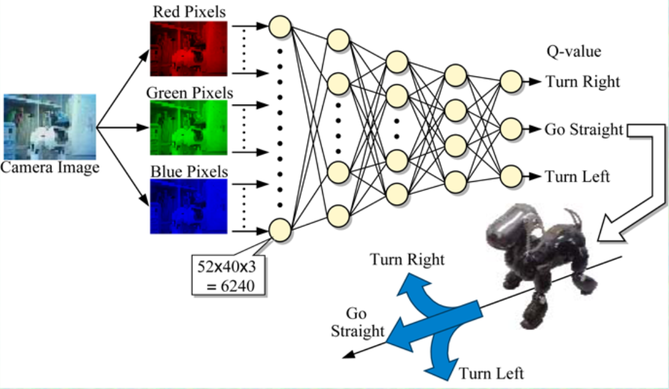
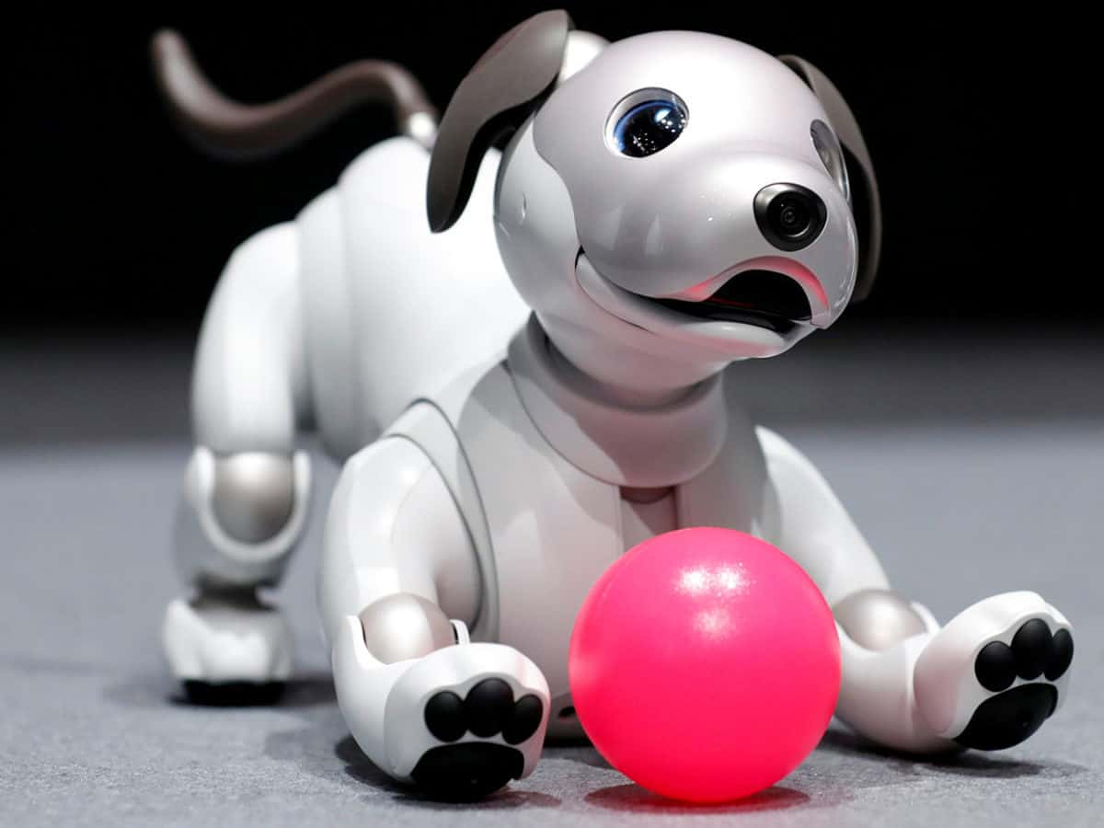
2008
2019
The world's first Deep Q Network applied to a Real Robot!
With new APIs, Sony’s robot dog could be the smart home assistant you’ve always wanted
https://www.youtube.com/watch?v=xpRcixf7gLo&t=337s
https://www.youtube.com/watch?v=mRtS812bKgk&t=17s

Slide 29
Deep Reinforcement Learning: Social robots
Sophia is a social humanoid robot developed by Hong Kong-based company Hanson Robotics.
Hanson designed Sophia as a suitable companion for the elderly in nursing homes, or to help the crowds at large events or parks.
Hopefully, robots will eventually be able to fully interact with other humans to gain social skills.
Sophia is known as a "social robot" that mimics social behavior and triggers feelings of love in humans.
https://www.youtube.com/watch?v=W0_DPi0PmF0&t=3s

Slide 30
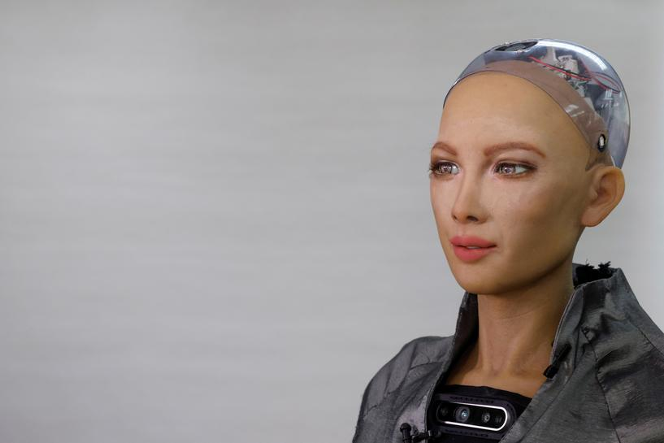
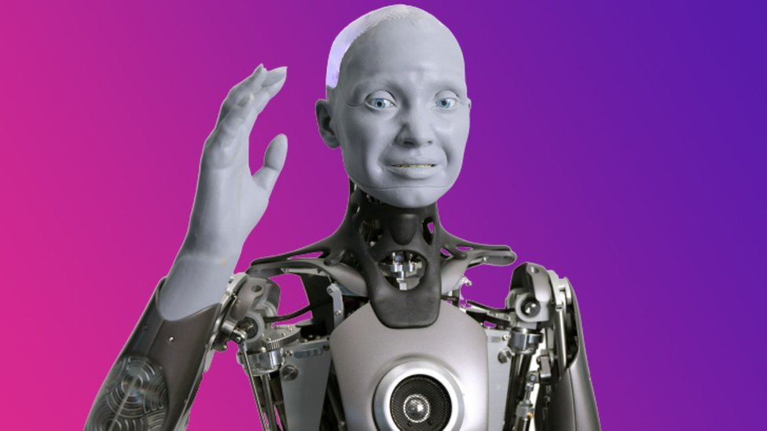
2016
2022
Sophia is a social humanoid robot developed by the Hong Kong-based company Hanson Robotics.
The main use case is for humanoid robot right now is entertainment, communication and interaction with other people," explained Engineered Arts Director of Operations, Morgan Roe, in his video. "Ameca is the pinnacle of what we can do. We didn't make her exactly like a human, we designed her as we envision robots of the future."

Slide 31
Comparison of Two Types of Robots
Robots based on human design are safe and reliable, but more difficult to handle complex tasks in complex environments.
Learning-based robots can adapt to complex scenarios, but require a lot of experimentation.

Slide 32

Introduction
to
Design Thinking

Slide 33
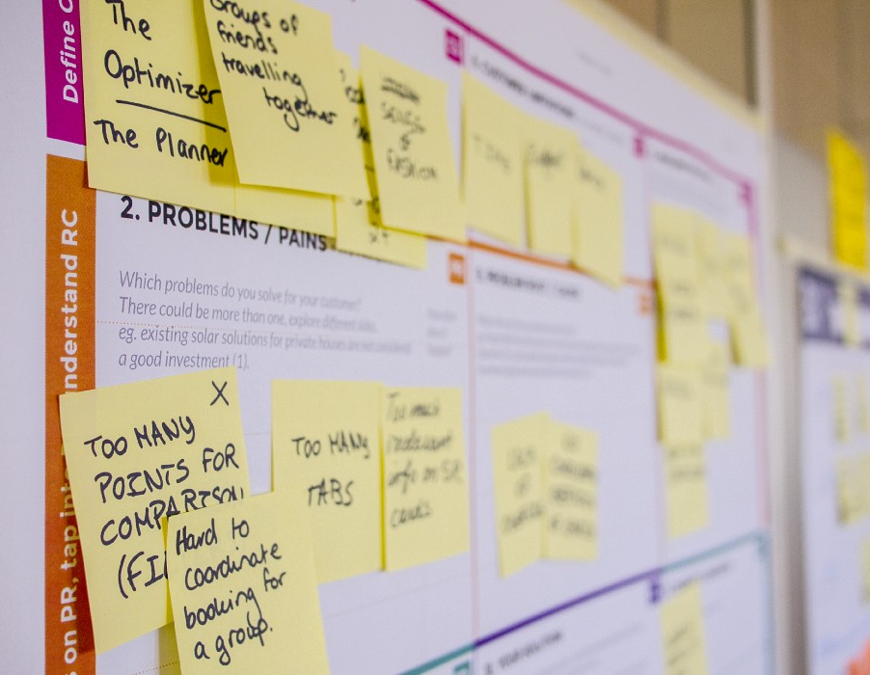
Introduction to Design Thinking
。
What is Design Thinking?
It is a people-oriented problem-solving methodology that seeks innovative solutions to various issues and creates more possibilities by starting from people's needs. Involving five stages — empathy, definition, ideation, prototype, and testing — it's most useful to address ill-defined or unknown problems.
The value of design thinking as a business driver of progress in the world (which global heavyweights such as Google and Apple have applied to remarkable effect) matches its status as a popular discipline among leading international universities. With design thinking, teams have the freedom to generate breakthrough solutions. With it, your team can gain hard-to-reach insights and apply a range of hands-on approaches to help find innovative answers.

Slide 34
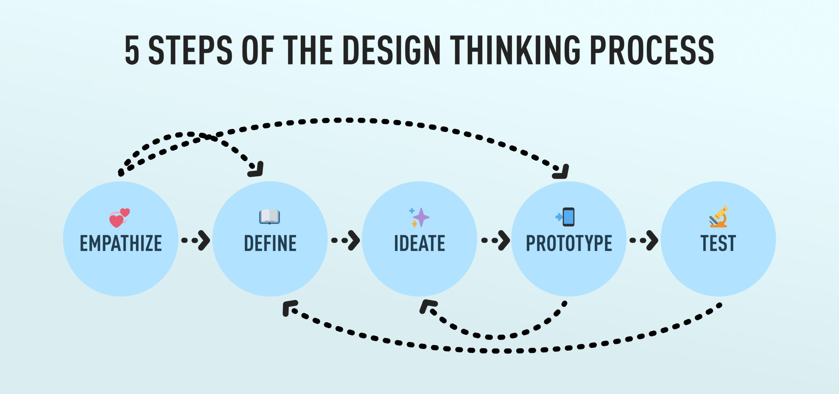
The Process of design thinking
Learn about users through testing
Empathise to help define the problem
Learn from prototypes to spark new ideas
Test reveal insights that redefine the problem

Slide 35
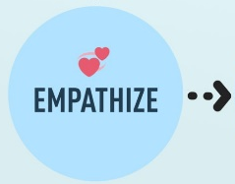
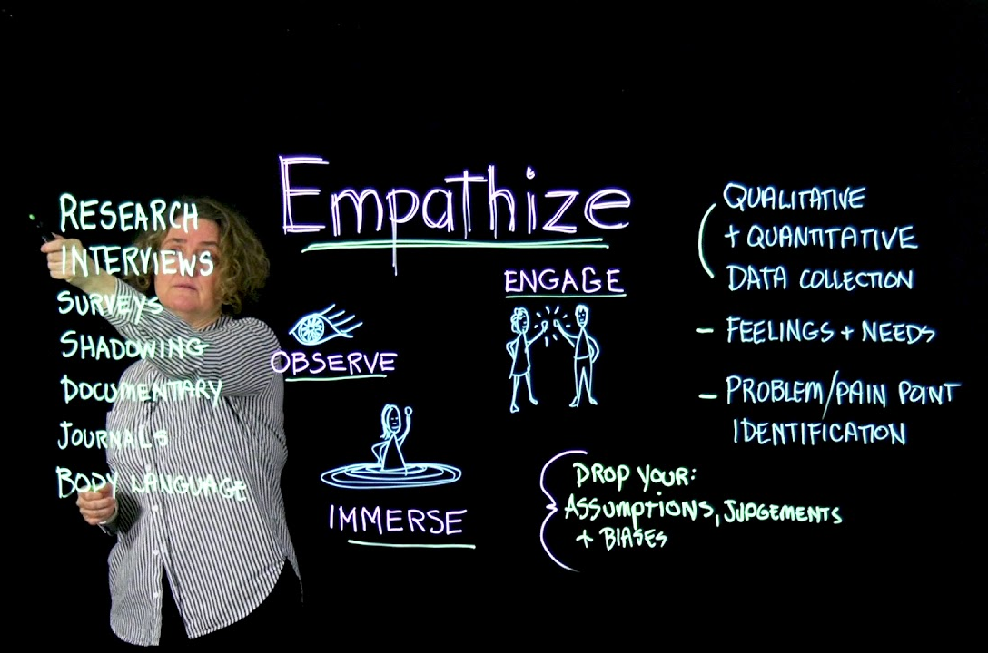
The Process of Design Thinking – Empathise
The first stage of the design thinking process is to have an empathetic understanding of the problem you are trying to solve.
This involves consulting experts to learn more about the area of interest by observing, engaging, and empathizing with people to understand their experiences and motivations, as well as immersing yourself in a physical environment so that you have a deeper personal understanding of the issues involved.
Empathy is essential for human-centered design processes, such as design thinking, and allows design thinkers to set aside their own assumptions about the world in order to gain insight into users and their needs.

Slide 36
The Process of Design Thinking - Empathise
Understand user behavior in the following ways:
Main sources of information:
1. Interview
2. Questionnaire surveys
3. Observe
Secondary sources of information:
4. Journals or magazines
5. Online research or offline news
Using the above methods, we can understand the user's pain points or user needs.

Slide 37
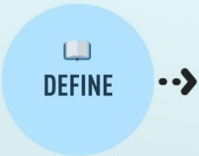

The Process of Design Thinking
– Define the Problem
In the definition phase, you put together the information you create and collect during the empathy phase. Here, you'll analyze your observations and synthesize them to define the core issues you and your team have identified to date. You should seek to define the problem as a problem statement in a human-centered manner.
The definition phase will help your team gather great ideas to build features, functionality, and any other elements that will enable them to solve the problem, or at least allow the user to solve the problem themselves with minimal difficulty.

Slide 38


The Process of Design Thinking
– Define the Problem
For example, rather than defining a question as your own desire or the needs of your company, such as "We need to increase the market share of our food among young girls by 5%," define the problem as a better approach, "Teenage girls need to eat nutritious foods to thrive and grow up healthy."

Slide 39


The Process of Design Thinking - Ideate
In the third stage of the design thinking process, designers are ready to start generating ideas. You already know your users and their needs in the Empathize phase, and you analyze and synthesize your observations in the Define phase to arrive at a people-centered problem statement.
With this solid background, you and your team members can begin to "think outside the box," identify new solutions to the problem statements you create, and you can start looking for alternative ways to look at problems.
There are hundreds of ideation techniques such as Brainstorming, Brainwrite, Worst Possible Idea, and SCAMPER. Brainstorming and worst-case possible idea sessions are often used to stimulate free thinking and expand the problem space. It is important to get as many ideas or solutions to a problem as possible at the beginning of the ideation phase.

Slide 40
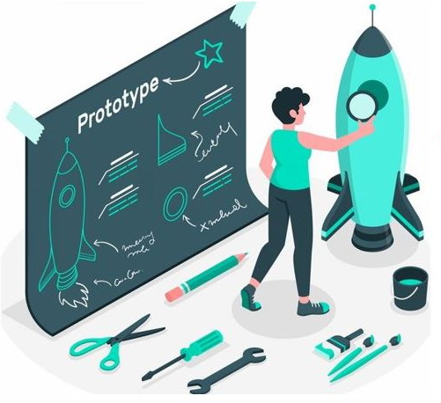
The Process of Design Thinking - Prototype
The design team will now produce some inexpensive, scaled-down version of the product or specific features in the product so that they can investigate the solution to the problem that arose in the previous phase. Prototypes can be shared and tested within the team, in a small group of people outside of other departments, or outside the design team.
This is an experimental phase with the aim of determining the best solution for each problem identified in the first three phases. The solution is implemented in the prototype and, based on the user's experience, investigated one by one, accepted, improved and re-examined, or rejected.
By the end of this phase, the design team will have a better understanding of the constraints and problems inherent in the product, and a clearer understanding of how real users behave, think, and feel about the product when interacting with the final product.

Slide 41
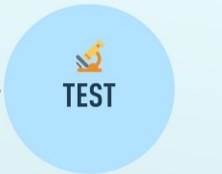
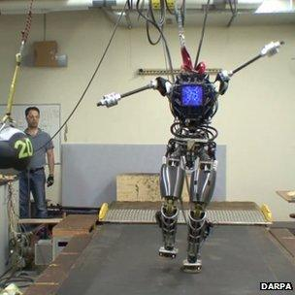
The Process of Design Thinking - Test
Designers or evaluators rigorously test the entire product using the best solution identified during the prototyping phase. This is the final stage of the 5-phase model, but during iteration, the results of the testing phase are often used to redefine one or more problems and inform the user of understanding, conditions of use, people's thoughts, behaviors, feelings, and empathy.
Even at this stage, changes and improvements are made to troubleshoot problem solutions and gain as deep a look at the product and its users as deeply as possible.

Slide 42
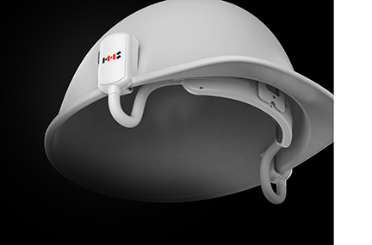

Design Thinking Example:
Bio-signal Processing Based Safety Monitoring System
A bio-signal processing module of HHS measures the status of workers in industrial sites in real time. It is a safety management system that notifies safety managers by monitoring dangerous situations in real time after measuring workers' status.
The developed product is effective in preventing accidents and responding quickly without a safety blind spot because the developed product acquires and analyzes the worker's bio-signals to fundamentally analyze the worker's risk situation. Furthermore, we provide a service that statistically analyzes data measured individually for long periods of time, shares it with family members, and manages workers' personal health

Slide 43
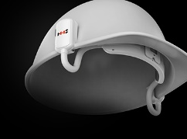

Design Thinking Case Study
(Empathise)
(Define the Problem)
Construction sites can be dangerous. There are a number of hazards present to those who are working on the job site, those who are visiting the site for inspections, or those who check the progress of the construction project. If your building is undergoing renovations or changes, you may have regular employees who are working in the building, as well as the construction workers who are working to renovate your building.
Preventing accidents and responding quickly without a safety blind spot
Shares it with family members, and manages workers' personal health

Slide 44
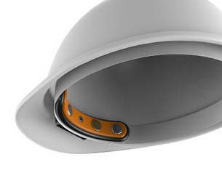
Design Thinking Case Study
(Ideate)
Connect to cloud platform
Long battery operation time
Gas leakage sensor to detect colourness of gas
Real time monitoring
Identify the conditions of worker
EEG based brain wave sensor to detect worker
Automatic emergency call request
Sleep detection
Apps to receive notification and status monitoring
Alarm to alert the worker
Easy to use
Compatible to multiple of helmet

Slide 45
Design Thinking Case Study
(Prototype)

Slide 46
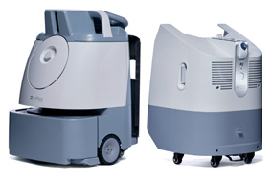
Design Thinking Example:
Disinfection Robot
AI-powered cleaning robotic
Whiz Gambit is a 2-in-1 AI-powered cleaning and disinfection robotic solution jointly developed by Avalon SteriTech and SoftBank Robotics Group.
The robot is the first disinfection robot to achieve Performance Mark by SGS, the world’s leading verification and testing company, with proven efficacy to eliminate >99% microbial bioburden. Importantly, Whiz Gambit greatly minimizes potential health risks in communal areas with its effective, consistent cleaning and disinfection performance. It has been a trusted partner for hospitality groups, shopping malls, schools, and offices around the world.
Disinfection System

Slide 47
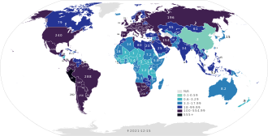

Design Thinking Case Study
(Empathise)
(Define the Problem)
office
hotel
mall
airport
The COVID-19 outbreak since December 2019 spreaded across the globe.
To provide an effective and highly efficient solution that results in better productivity and consistency to enhance environmental health and safety.
“What we've seen with labor shortage happening, some of these more menial, repetitive tasks people don't want to do anymore,”
“As a response to labor shortage, having something that is autonomous and robotic, is more in demand than anything we've ever seen in the past.”

Slide 48
Design Thinking Case Study
(Ideate)
Autonomous navigation
Long battery operation time
Teach the cleaning route manually
Disinfection spray function
AI to determine the best route
Maximize the spray distance
Obstacle avoidance and fall prevention
Automatically turn on/off spray
Emergency brake function
Adjusted to target zone or surface
Apps to check status and control
Preventing excessive use of chemicals
Easy to use
Easy to install

Slide 49
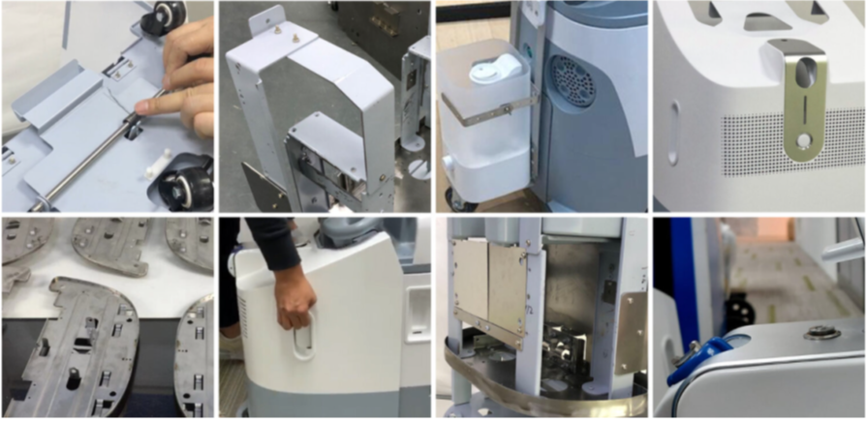
Design Thinking Case Study
(Prototype)

Slide 50





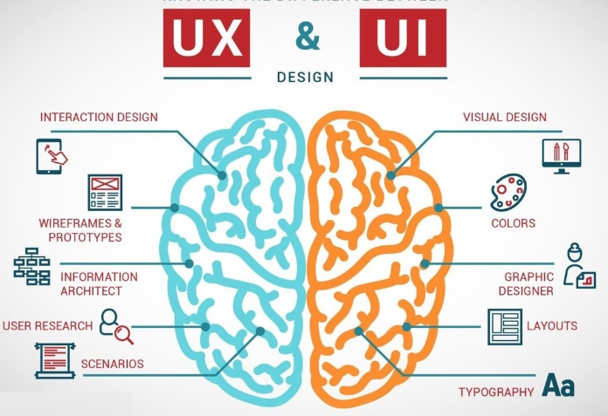
Design Thinking — The Role of the Participant
Design thinking should include : creativity, design, customer experience, engineering, innovation, product, R&D, strategy, and user experience.

